Slide 1
60 Years ago, the Brunei Revolt occurred.
It was quickly put down but President Sukarno of Indonesia then embarked on a “Confrontation” against Malaysia.
Confrontation in Sabah and Sarawak ended two years later but military survey work, which had commenced shortly after World War Two, continued until the early 1970’s.
This slideshow, based on dusty slides taken in mid-1966, shows the clearing of Hill 2360 in eastern Sabah for use as an altimeter-heighting base.
The party moved by launch from Tawau to Kalabakan where it was lifted to Hill 2360 by an R.M.A.F. Alouette III.
Hill 2360 was fixed by bearing and distance from a trig point called Moritok.

Slide 2
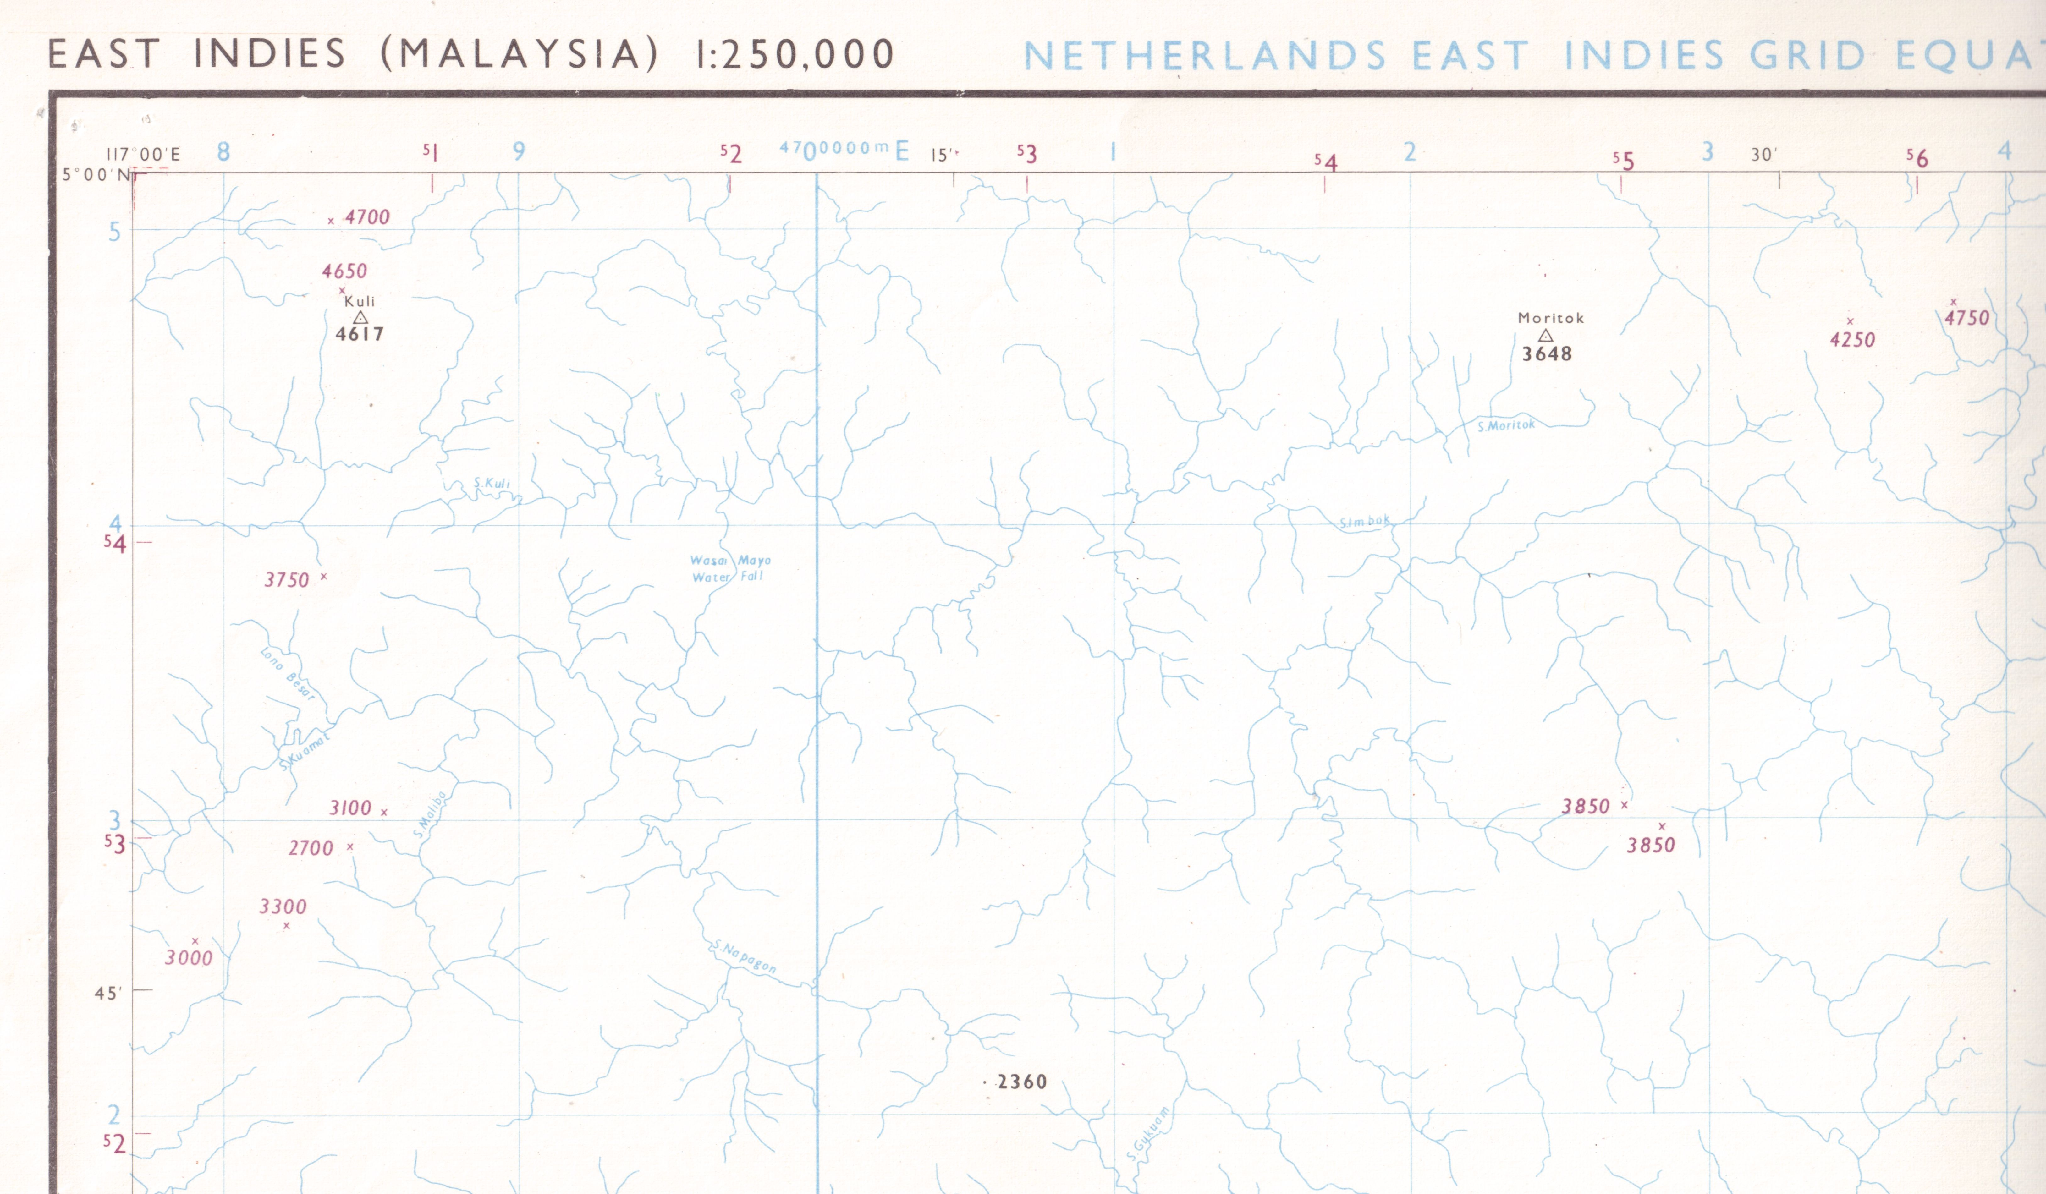
Series T503 Sheet NB 50-15 Edn 1-GSGS.
2 Troop 84 Svy Sqn trig points Kuli 4617 and Moritok 3648 are shown.
Hill 2360 is at grid ref 0722 on a bearing and distance of about 210 degrees and 32 kms from trig Moritok.

Slide 3
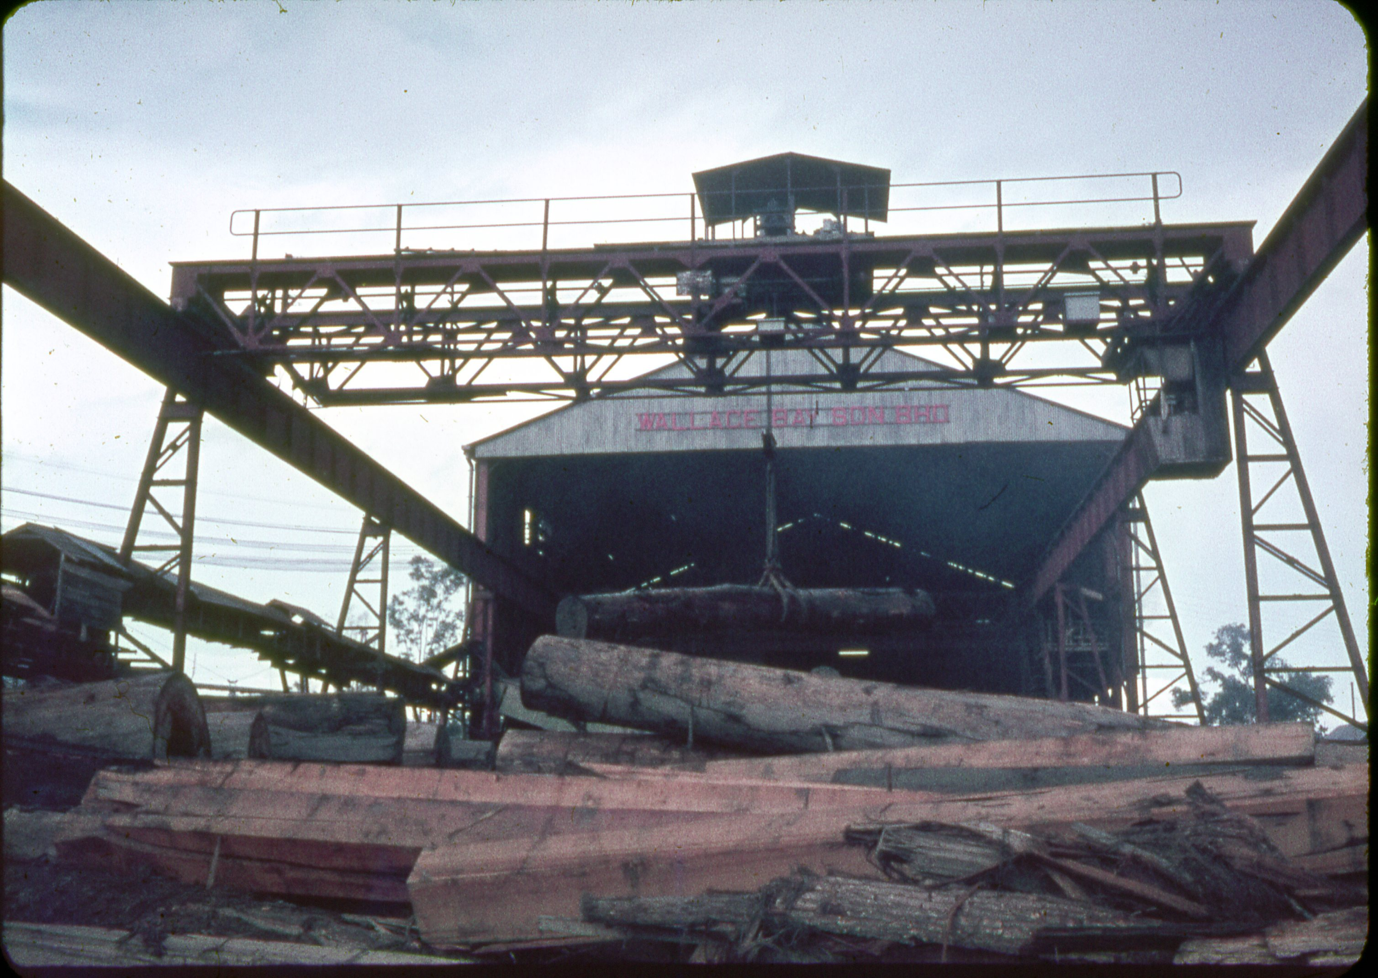
The Wallace Bay Timber Company at Pulau Sebatik

Slide 4
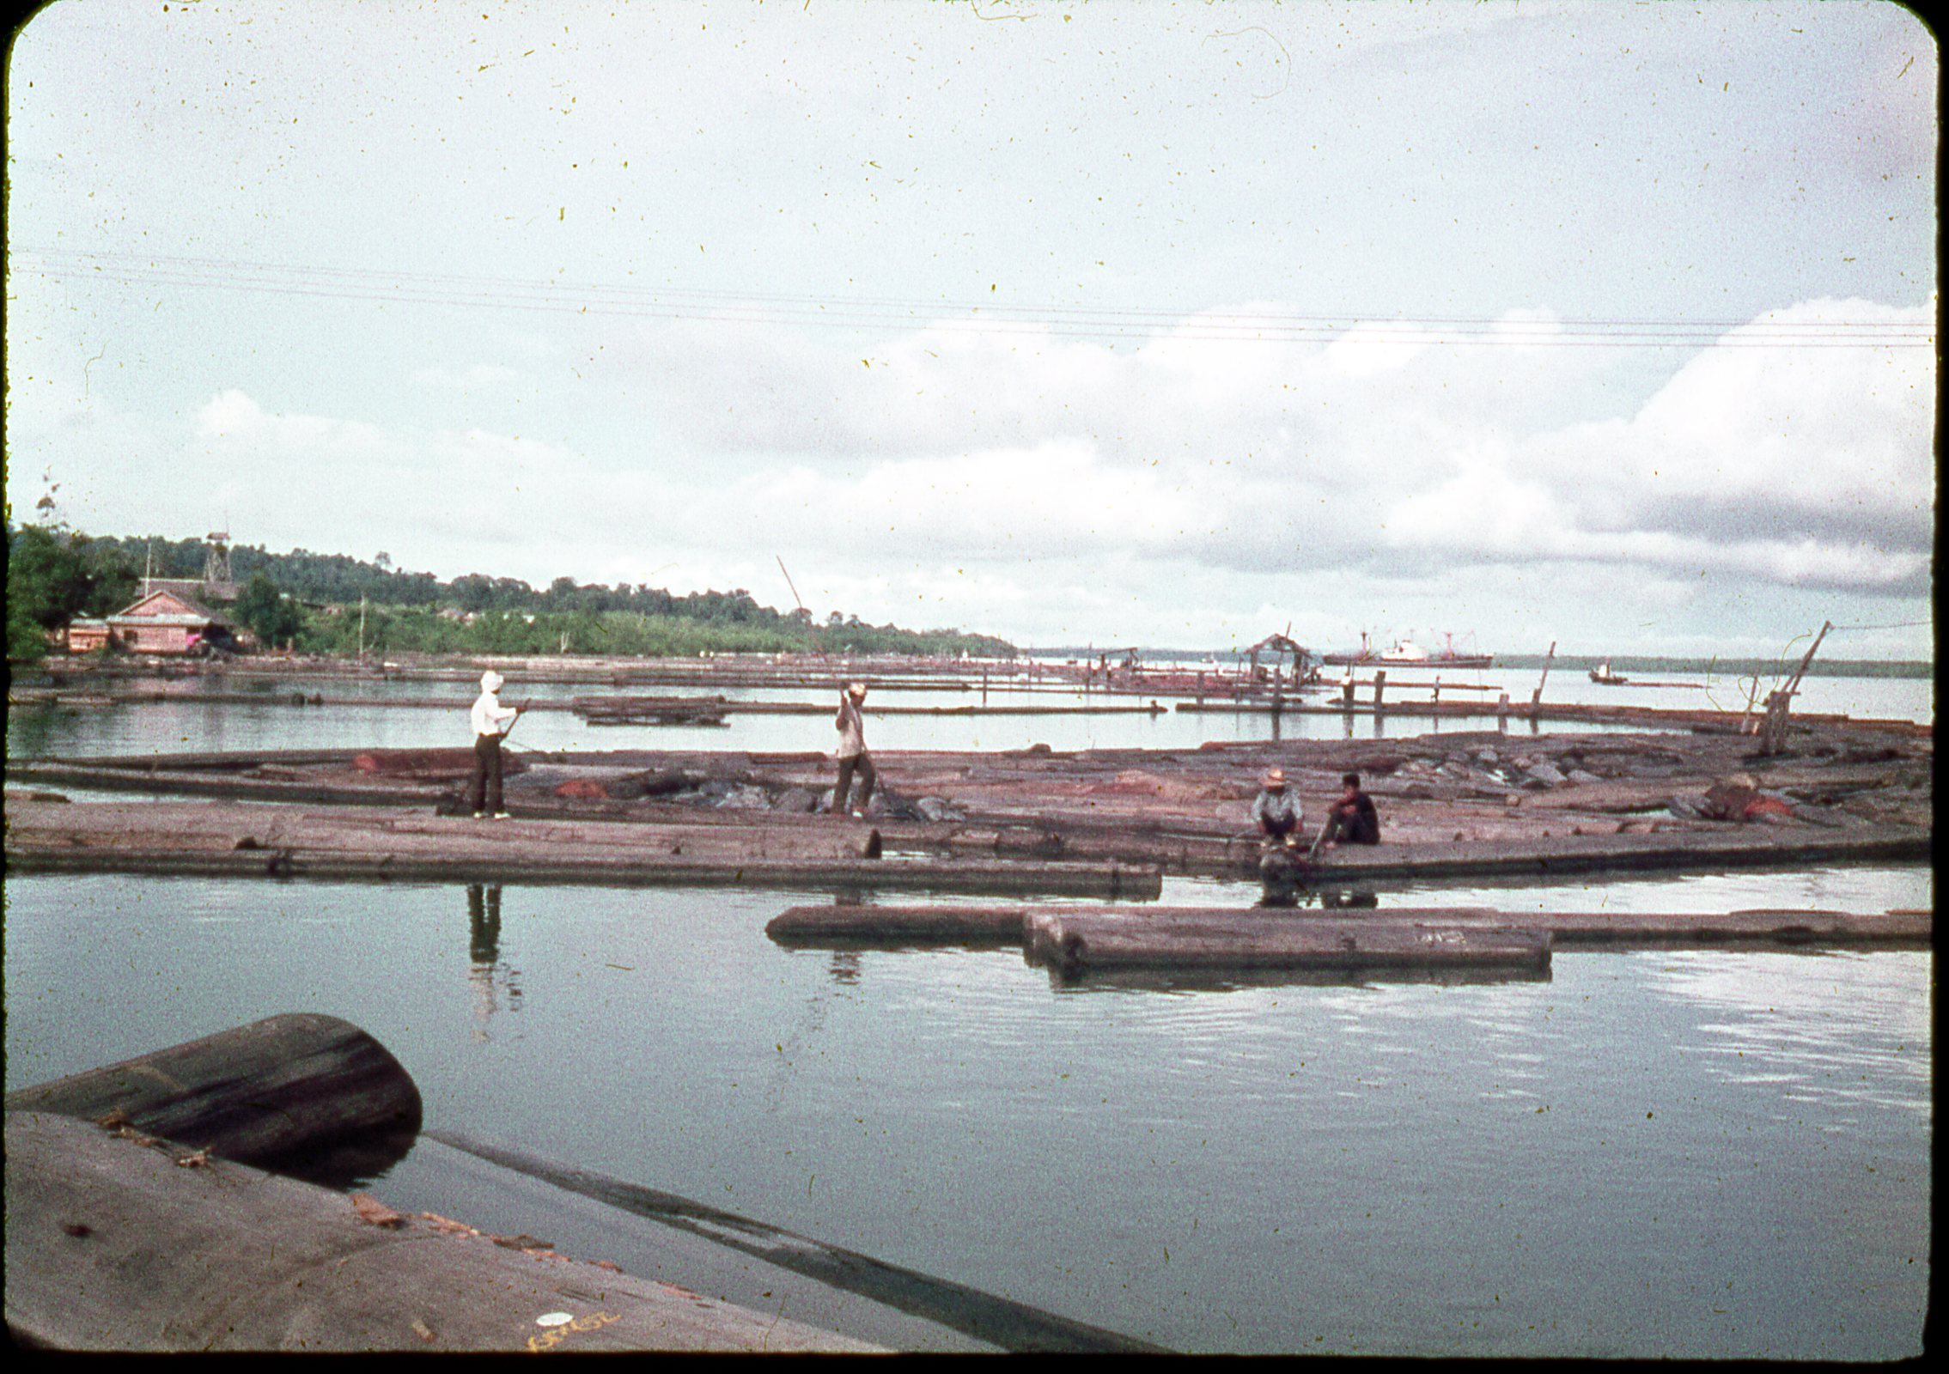
Wallace Bay Timber Ponds at Pulau Sebatik.

Slide 5
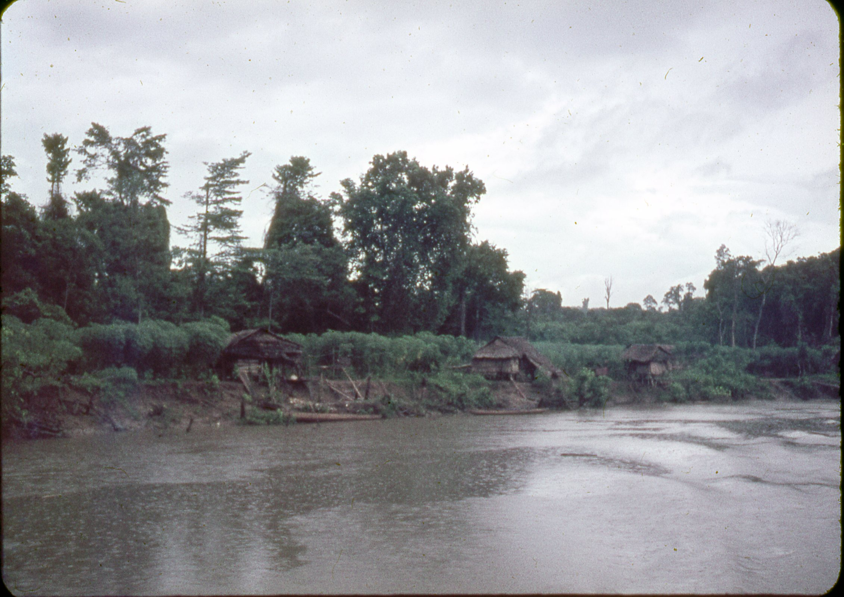
Kalabakan River, Huts and Tapioca crop.

Slide 6
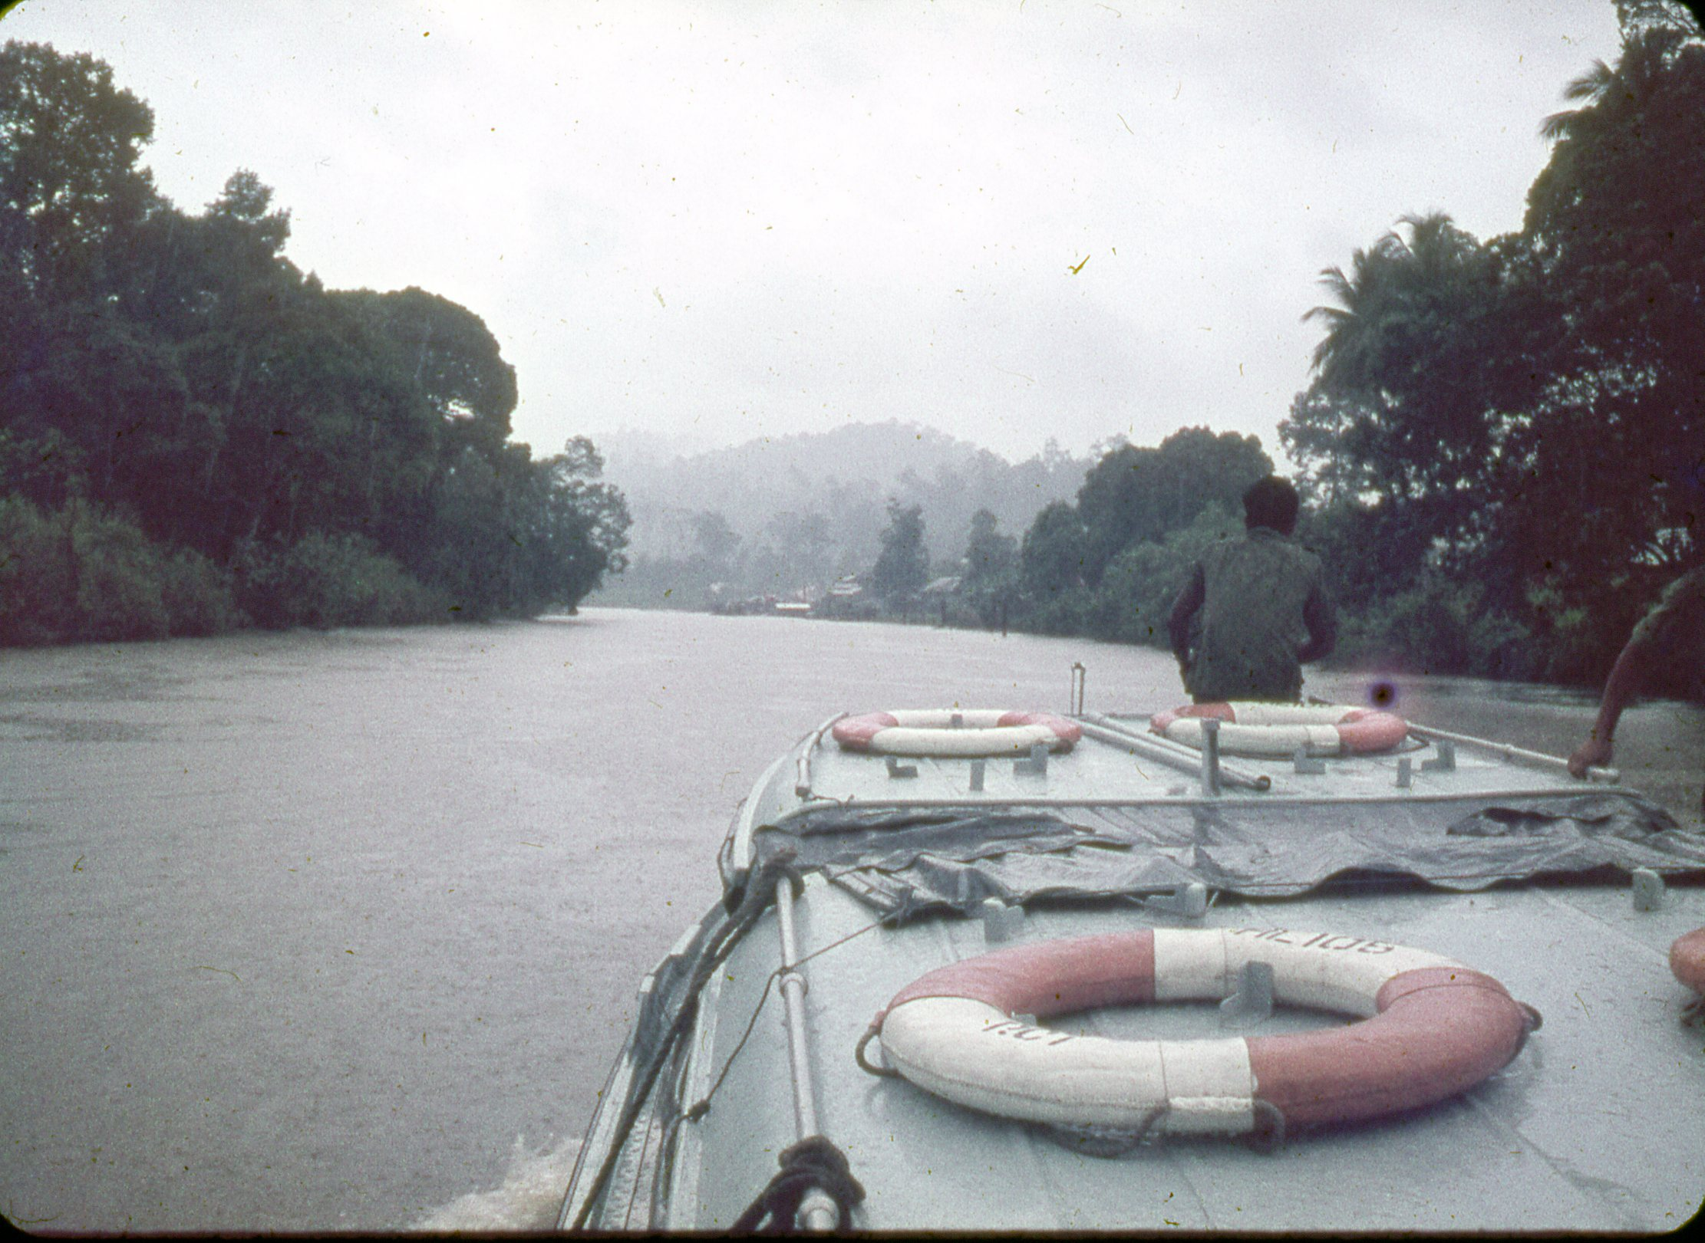
R.A.S.C. Motor Launch 105 approaching Kalabakan

Slide 7
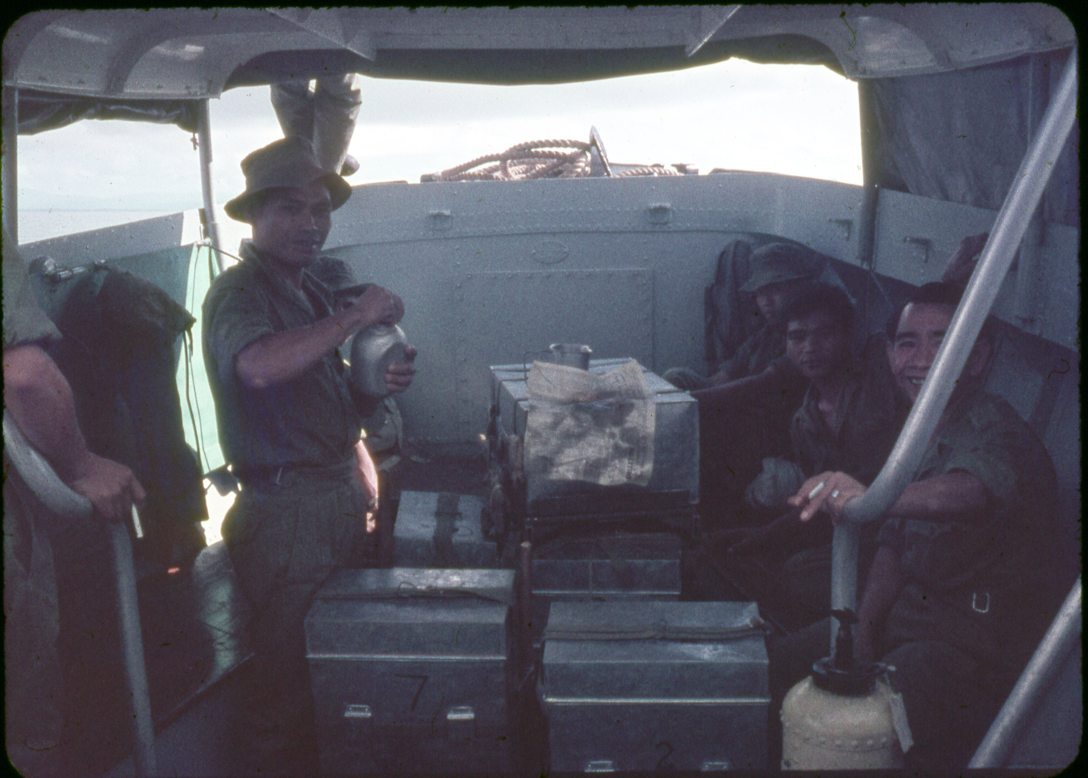
Our labourers en route to Kalabakan in R.A.S.C. launch.

Slide 8
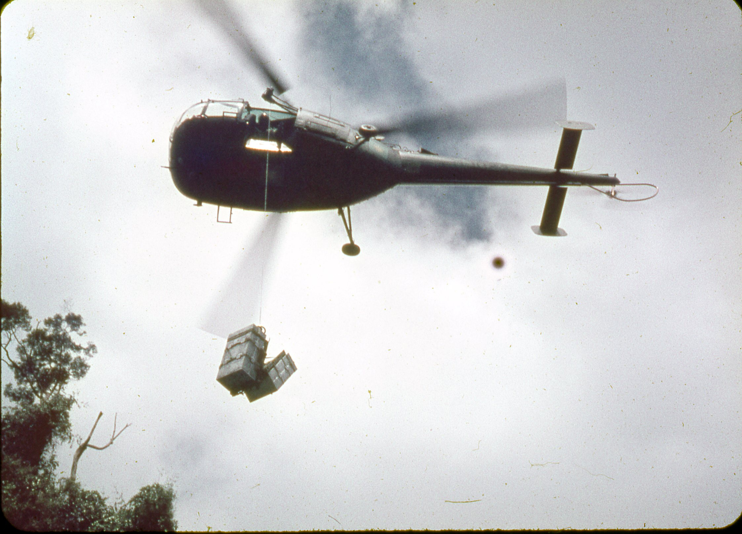
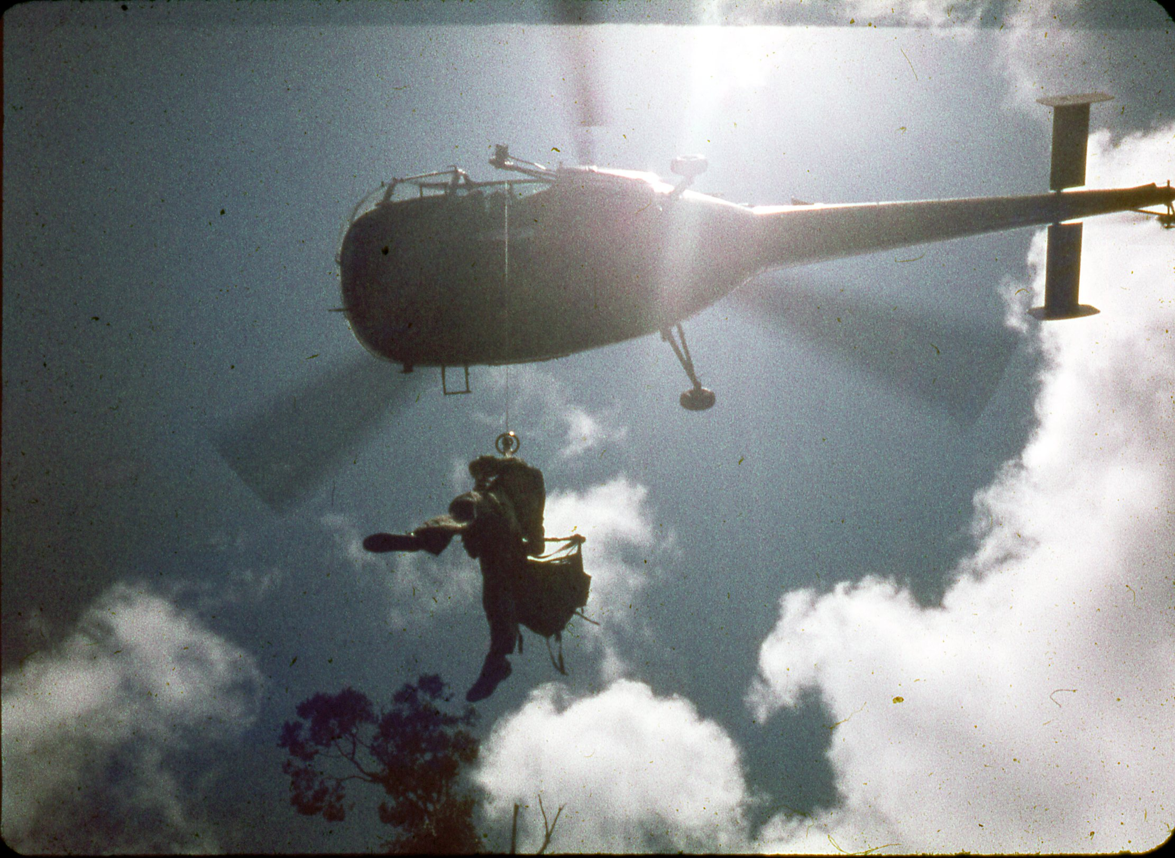
Cpl Hobson winching down from the R.M.A.F. Alouette III
The first man down receiving the “bongon” stores containers.

Slide 9
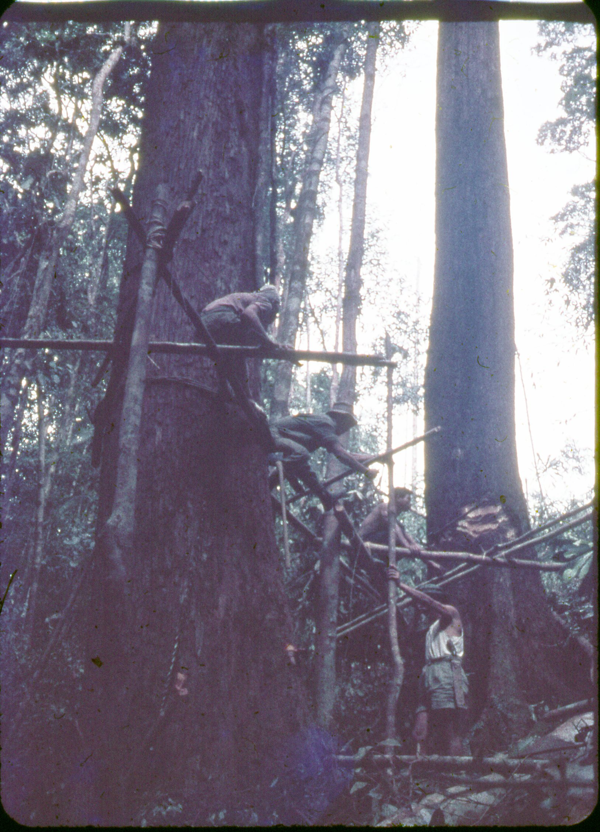
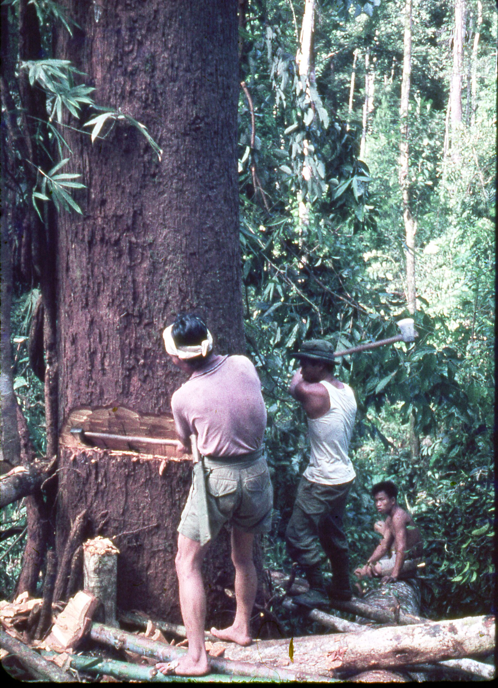
Cutting above the buttress roots on platforms.

Slide 10
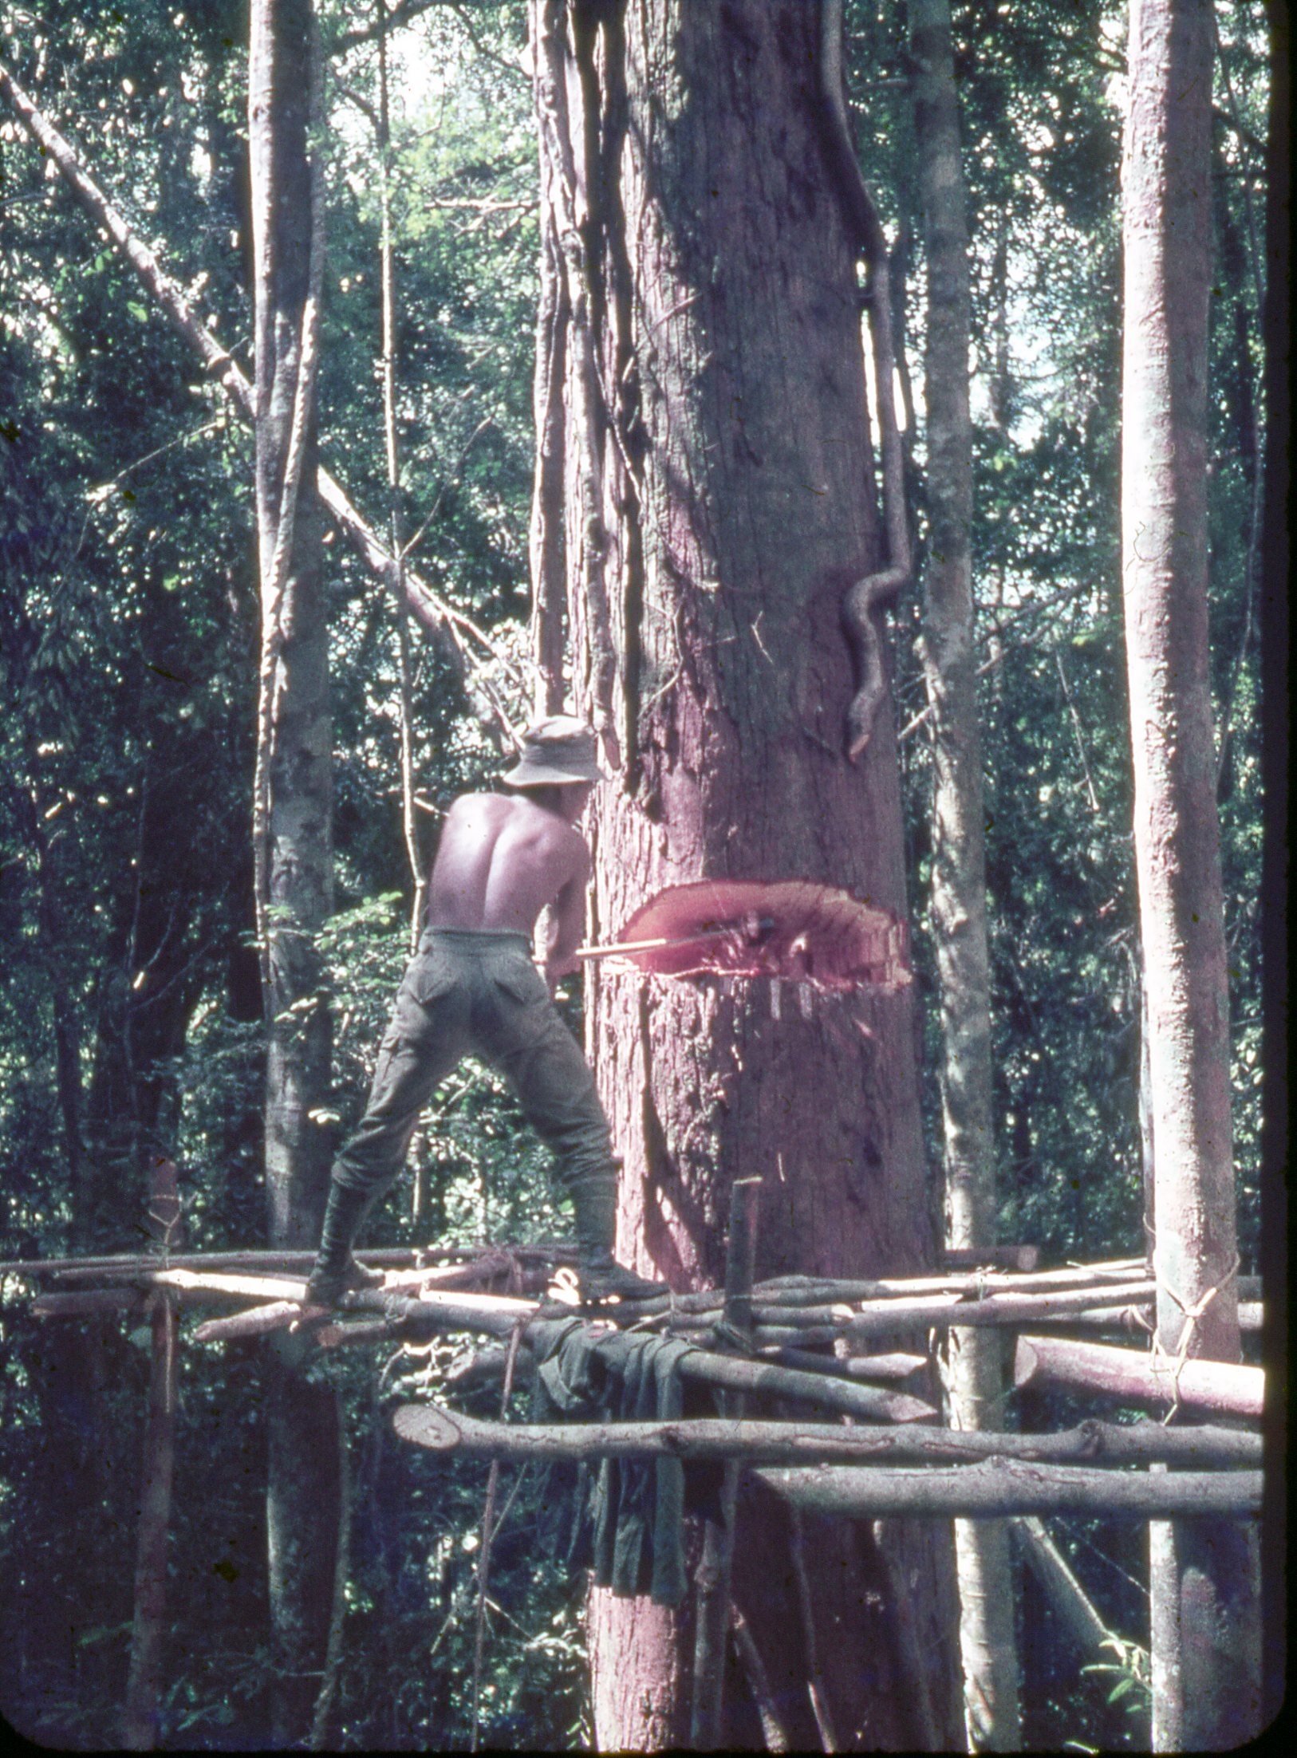
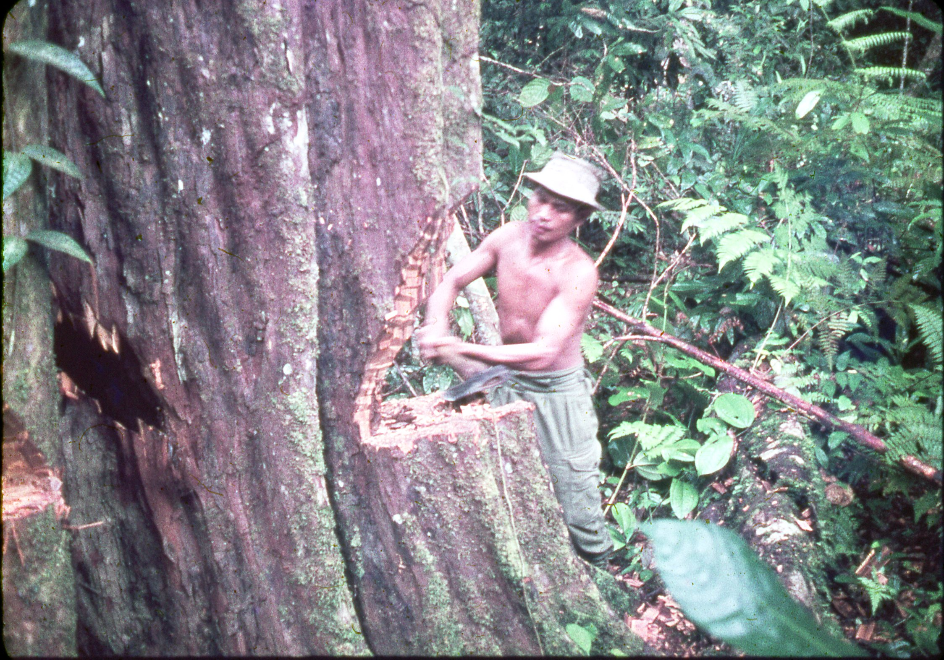
The “Muruts” used locally bought Japanese 2-pound axes in preference to the heavy M.O.D. axes held by the Troop.
The Danarm power saw held on the Troop G1098 was never used.

Slide 11
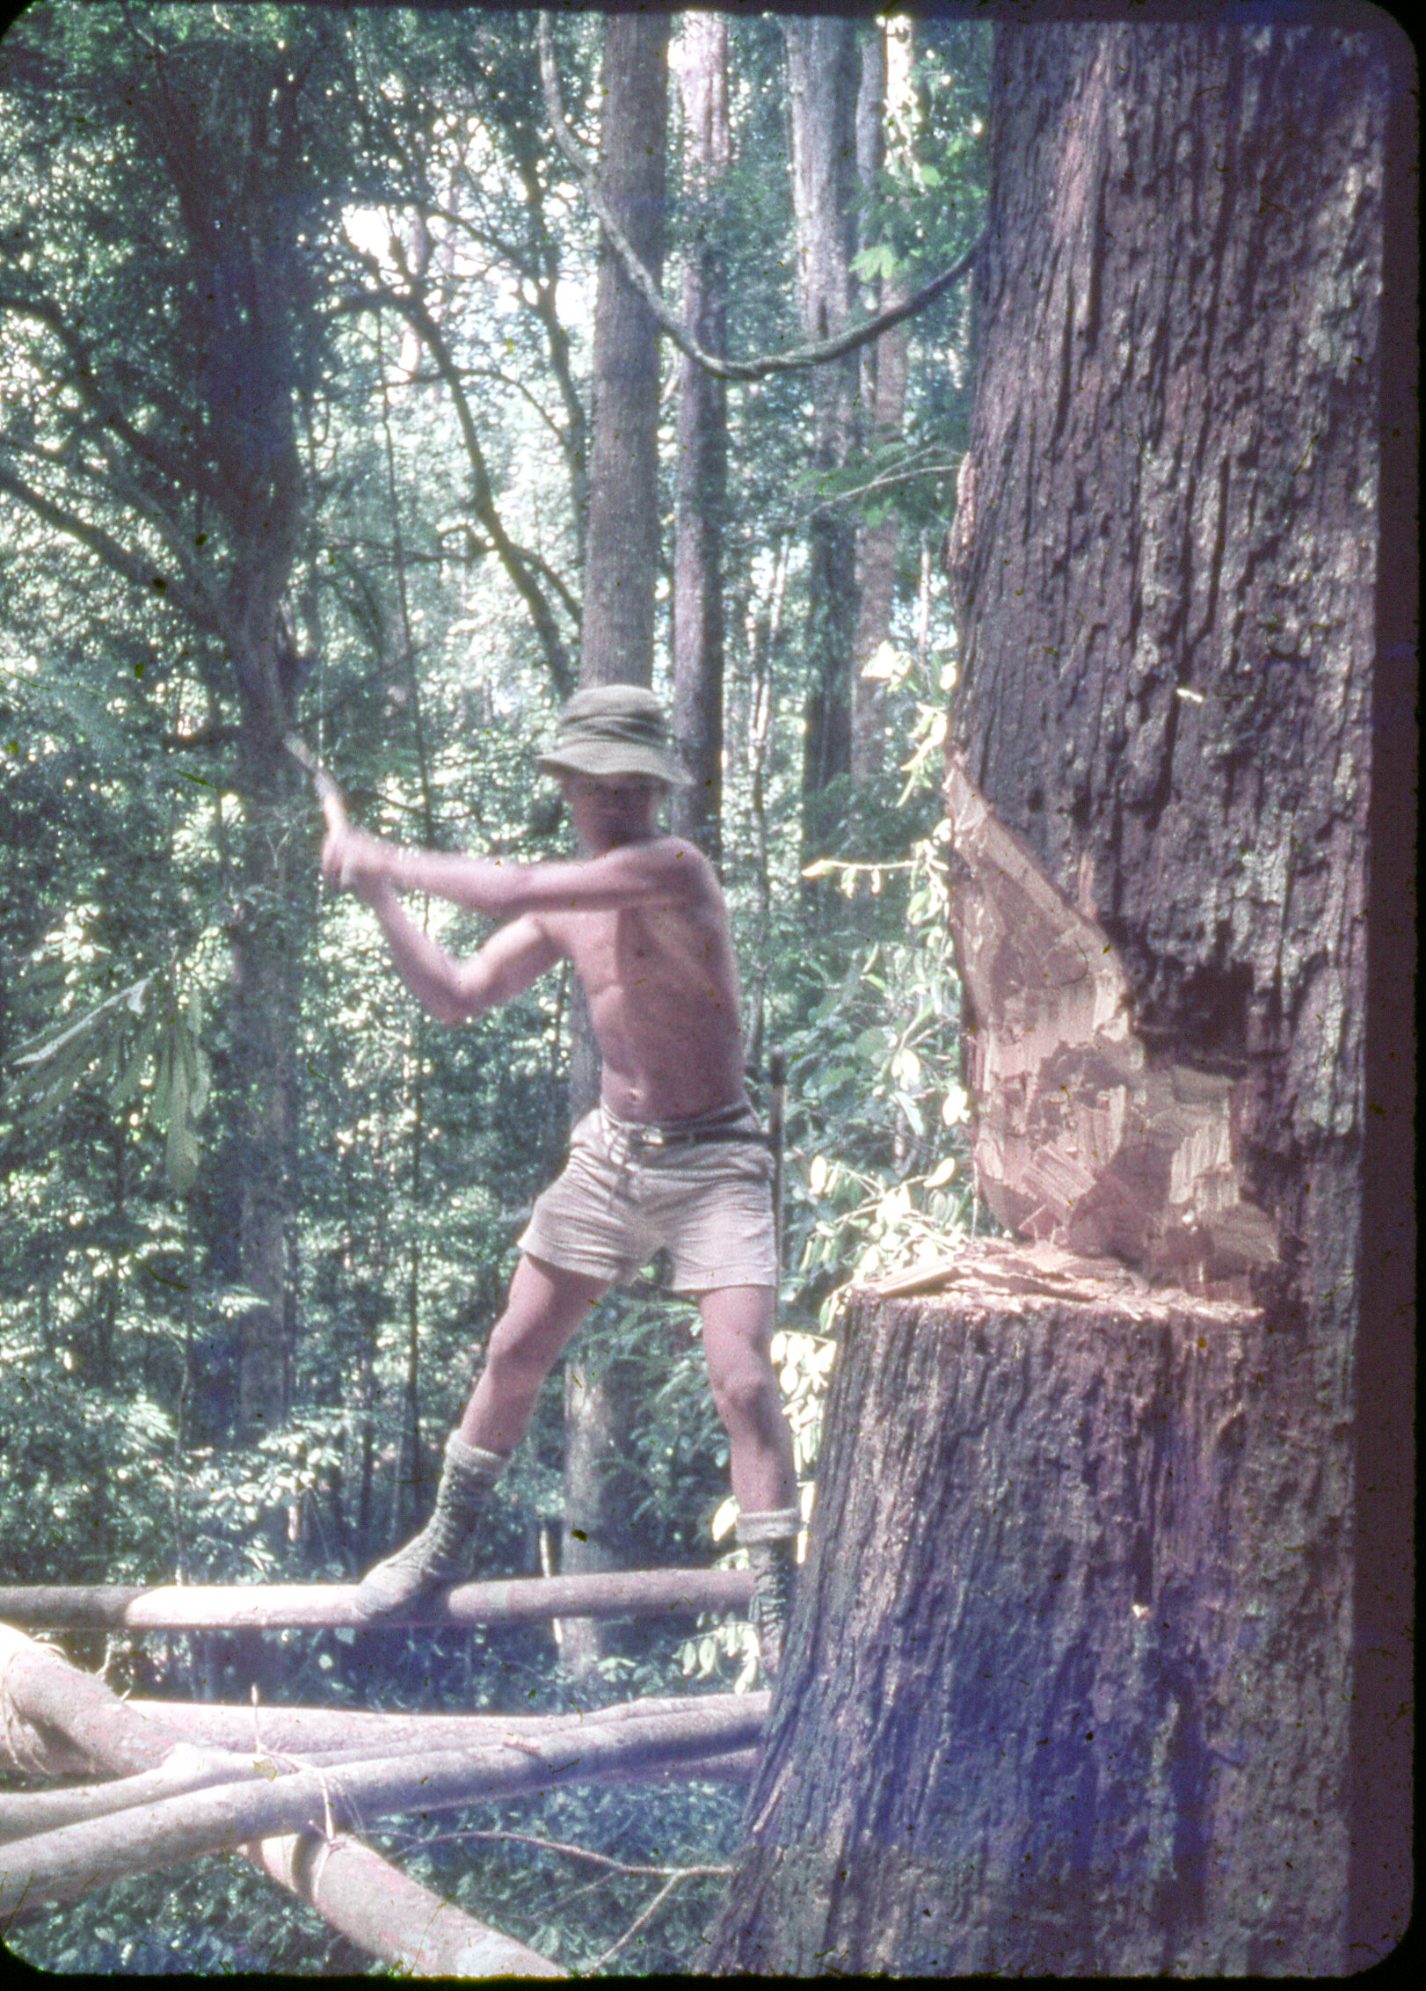
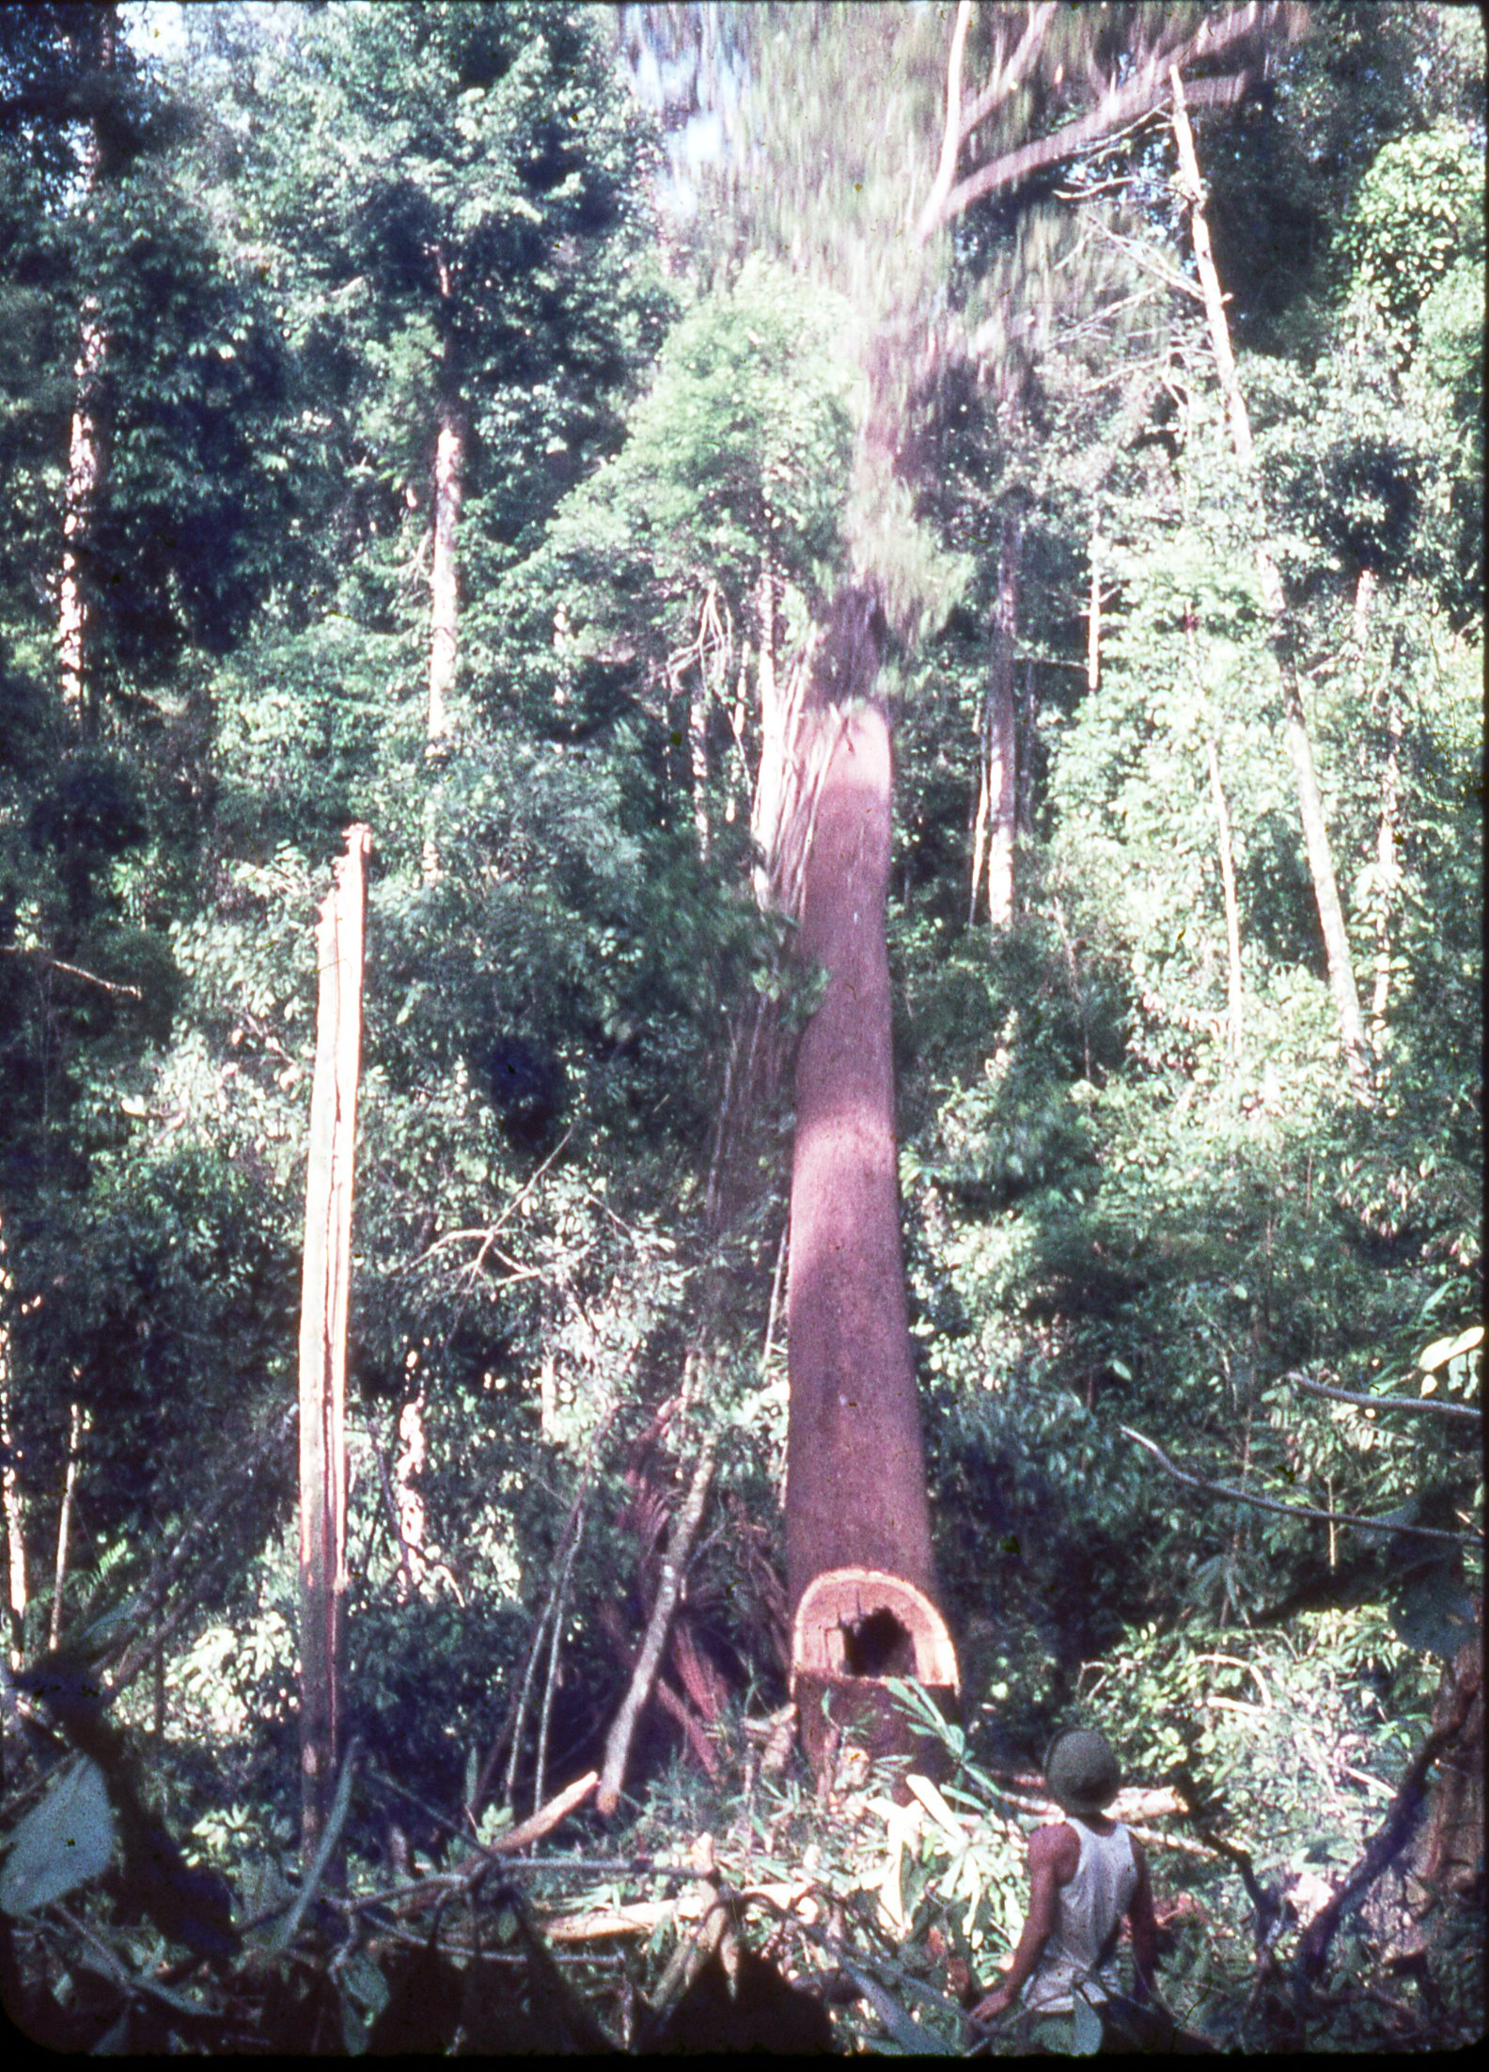
The knack was to make a wide enough cut to cut deep into the tree.
A hollow tree falling followed by a cloud of leaves.

Slide 12
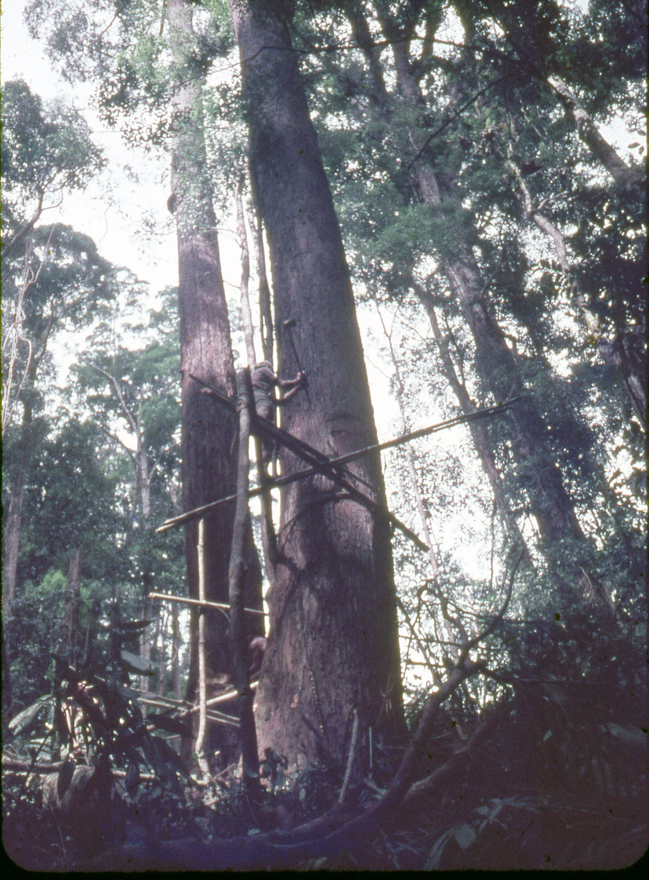
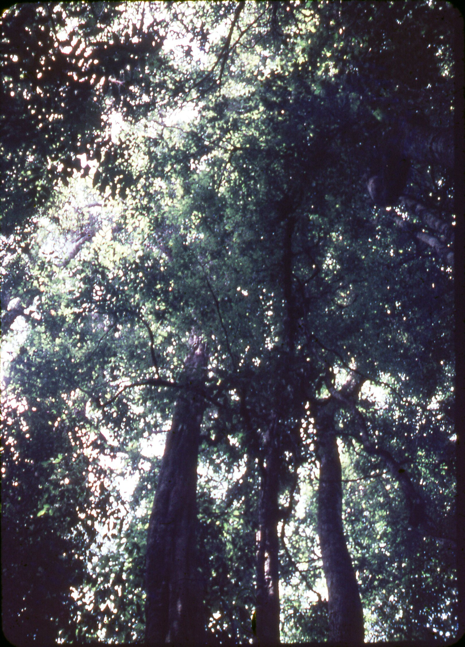
A very high cut
&
The canopy

Slide 13
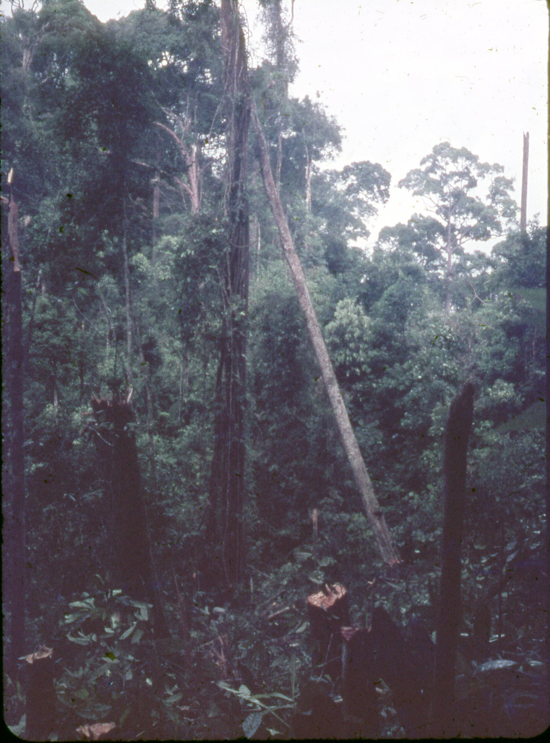
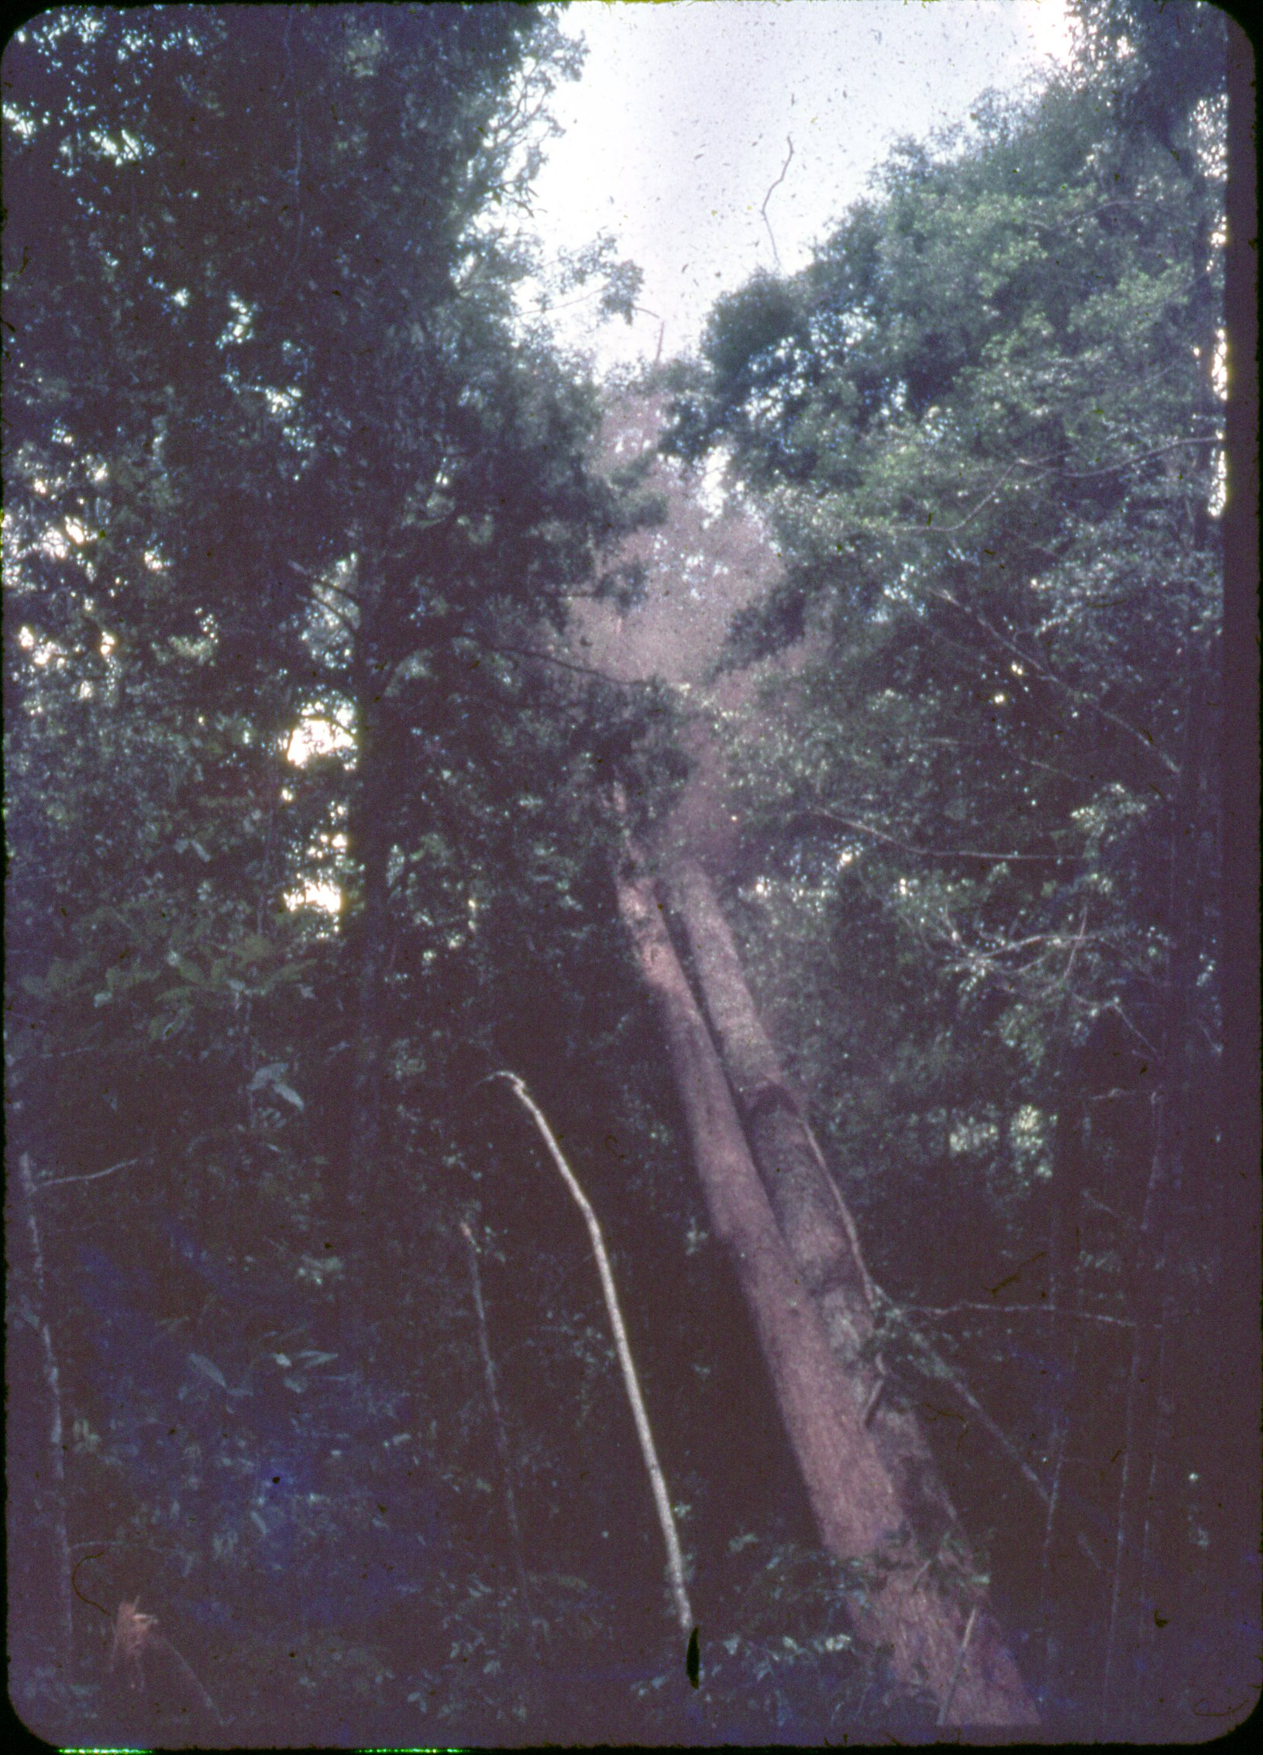
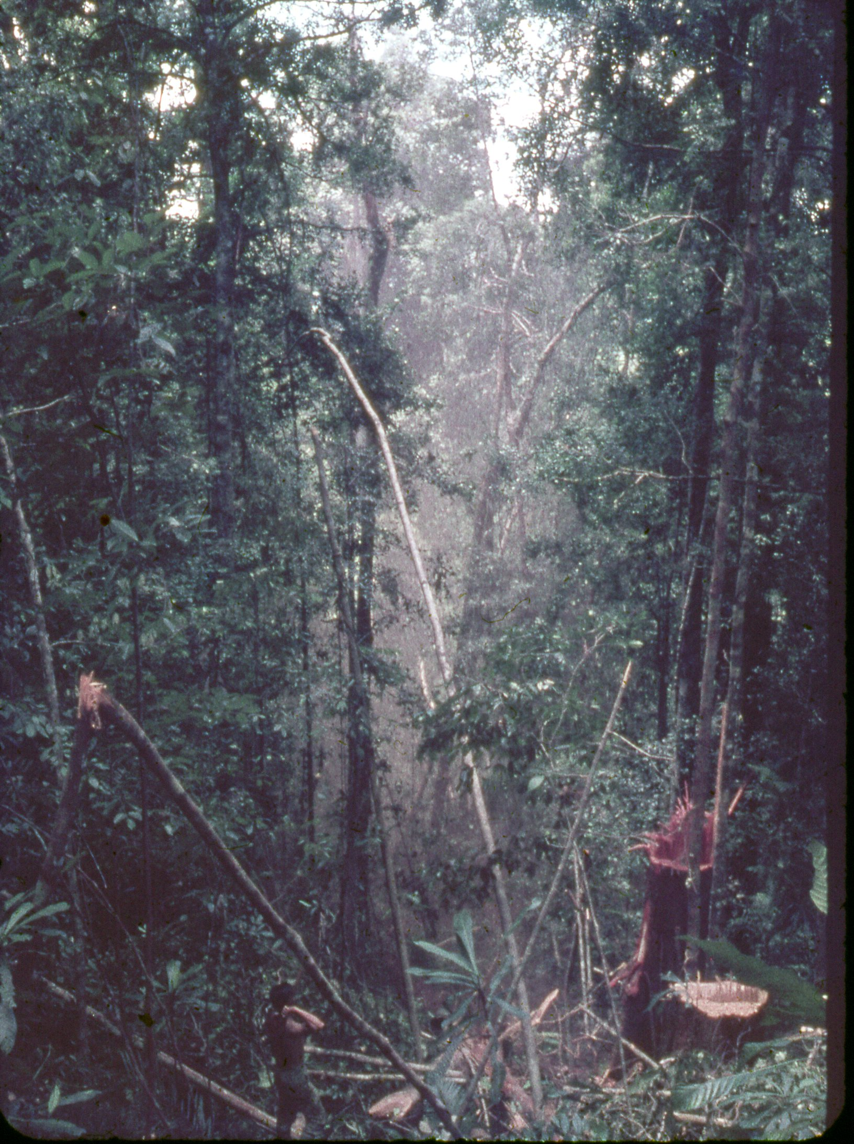
Trees falling.

Slide 14
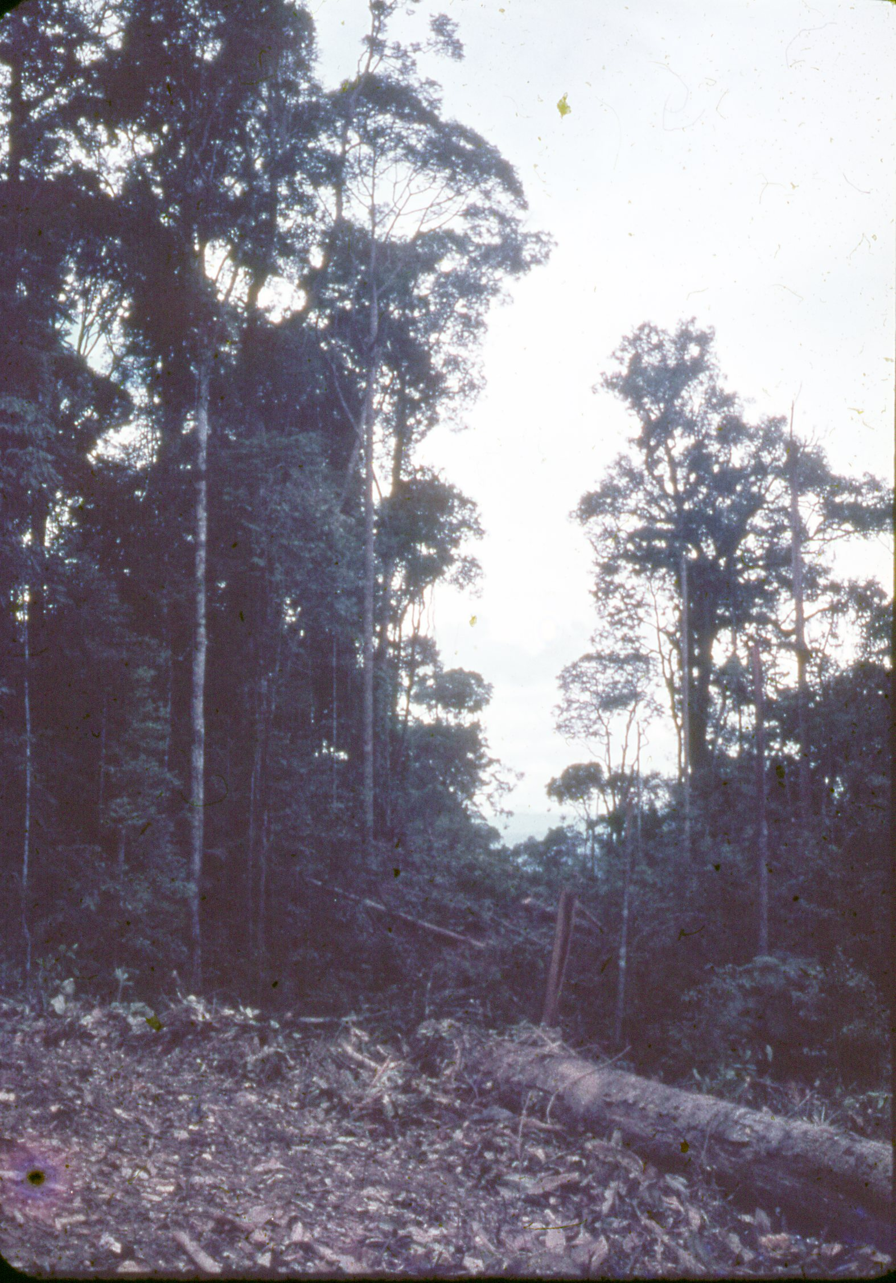
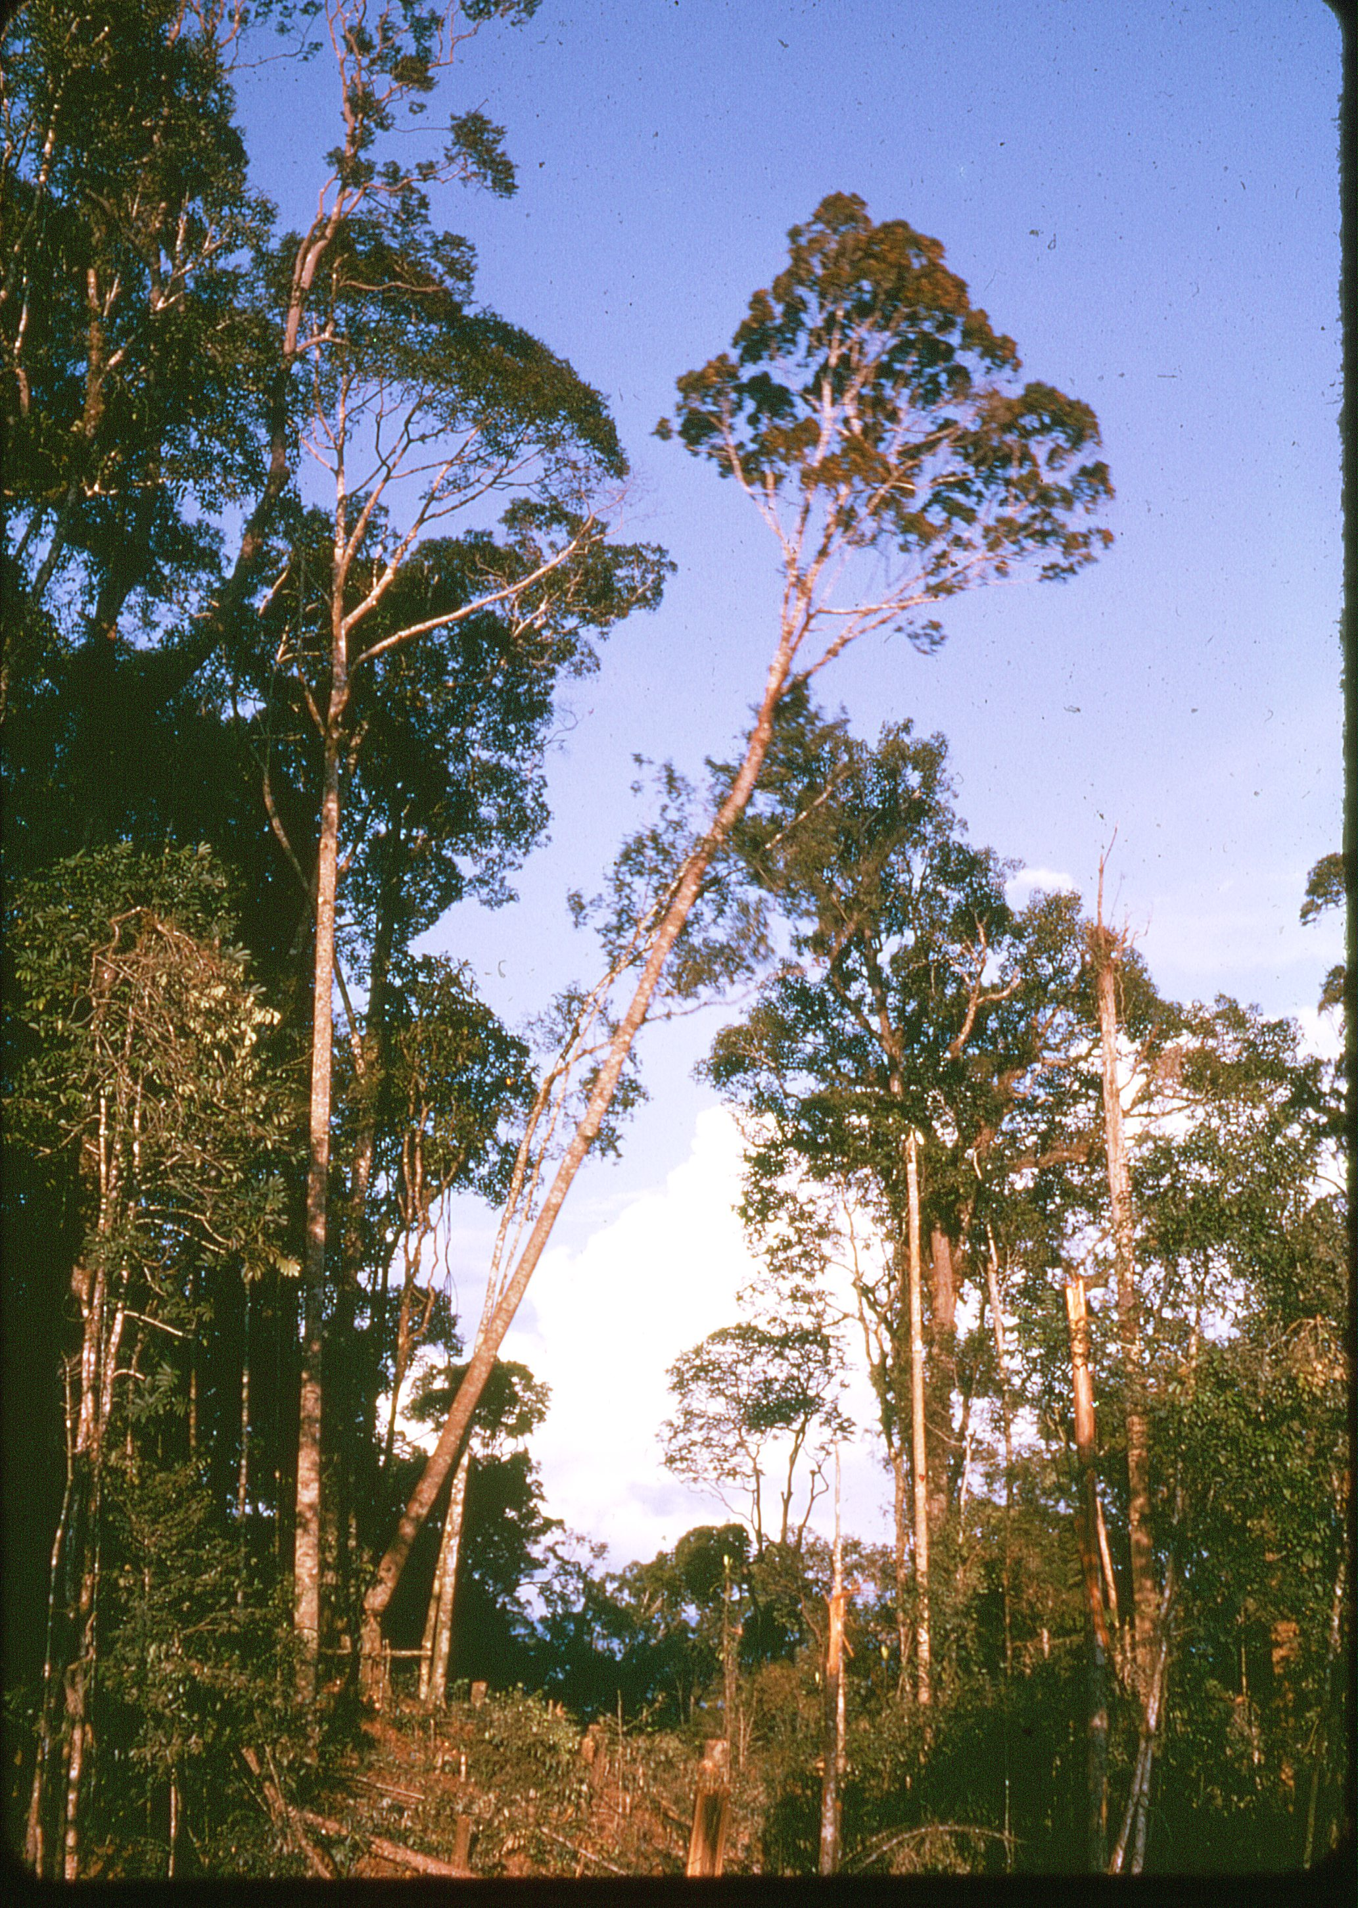
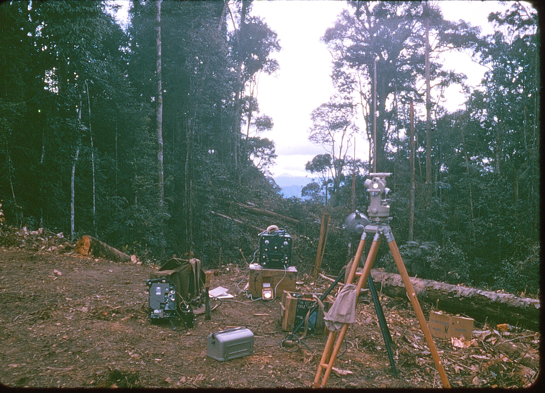
The trig on Moritok visible in the distance through the “Rentis” or cutting.
Watts Microptic theodolite, Tellurometer MRA 2 and A-13 High Power radio.

Slide 15
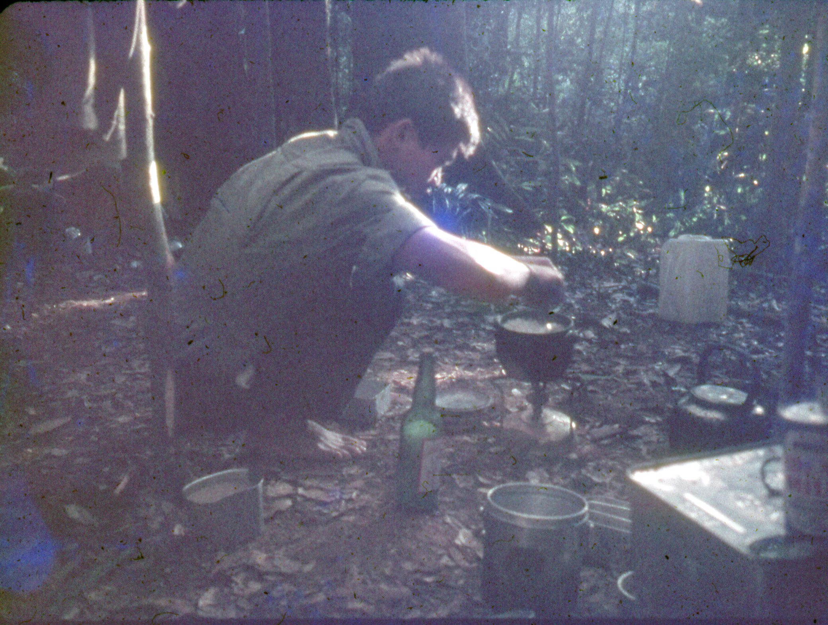
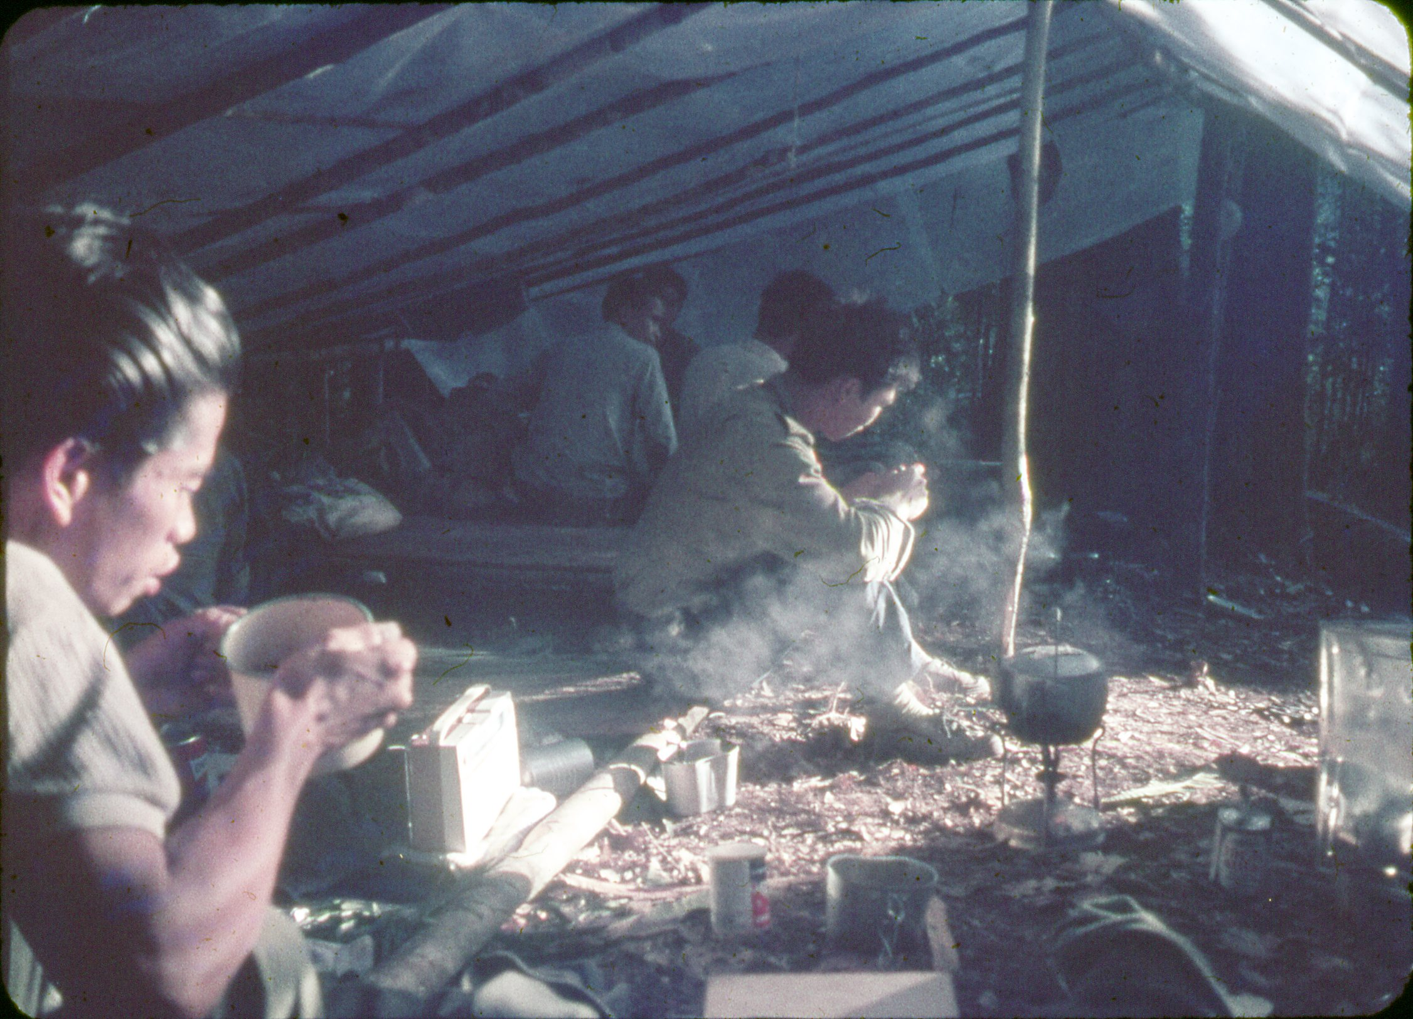
The evening meal, Barok and Lawrence in foreground.
Lawrence cooking the evening meal of rice in a “priok” on a primus stove.

Slide 16
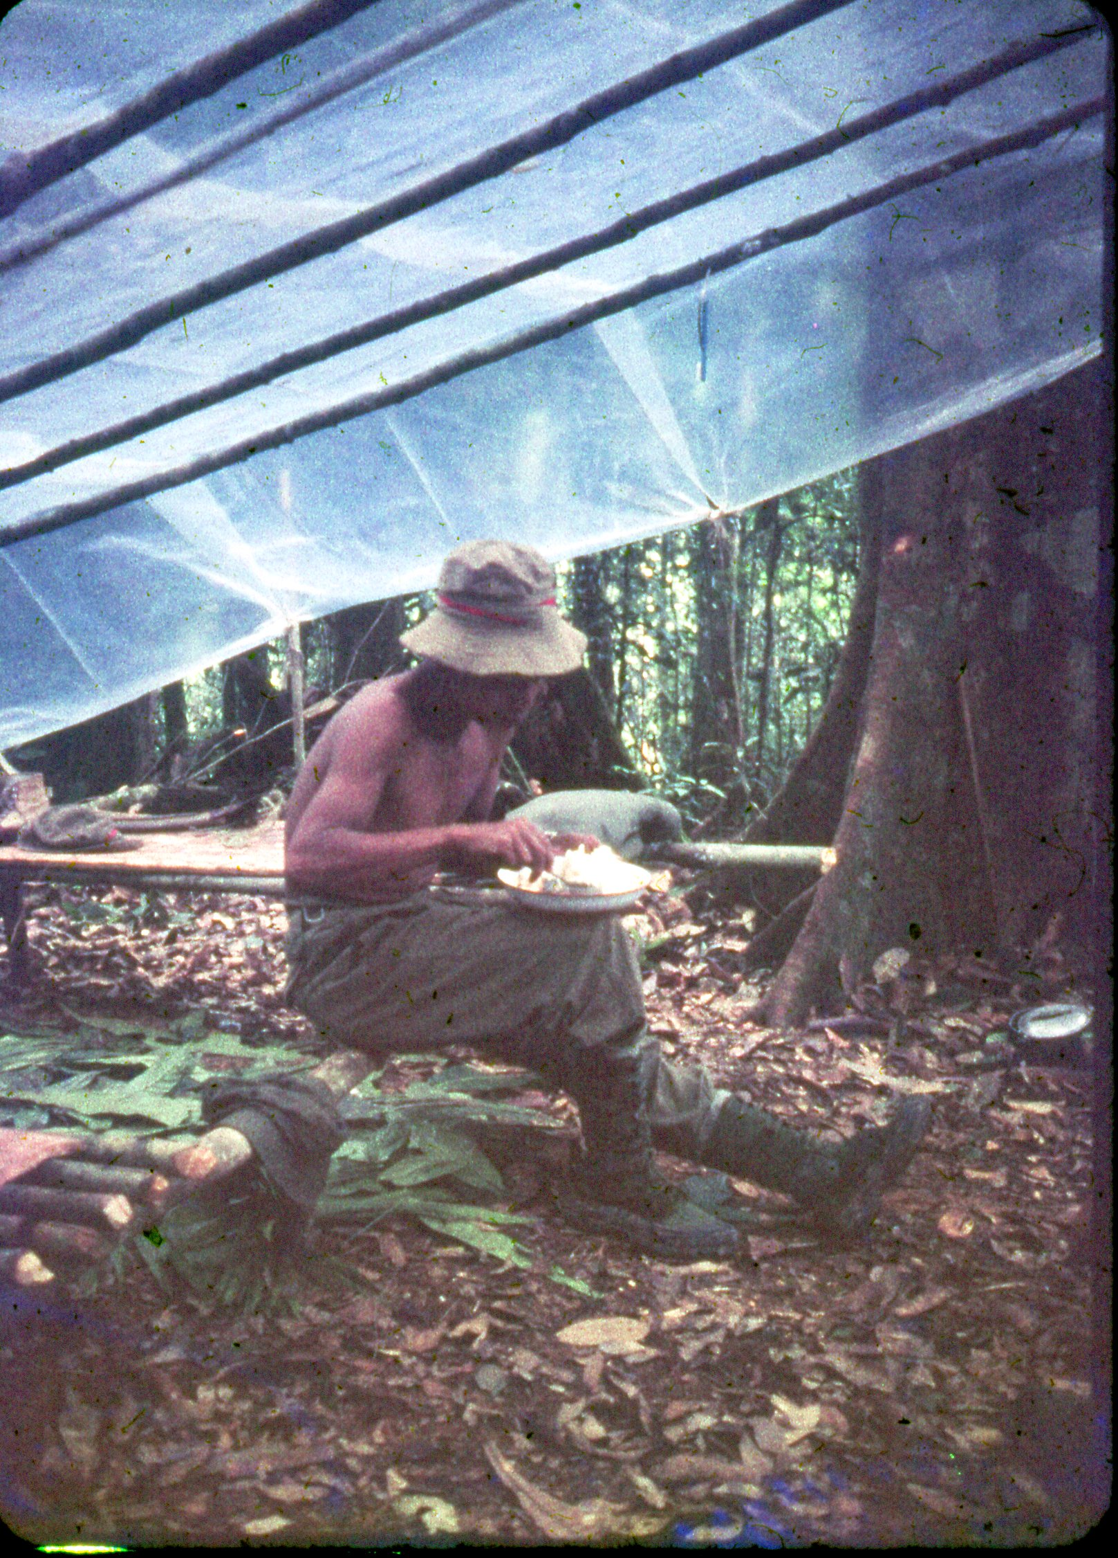
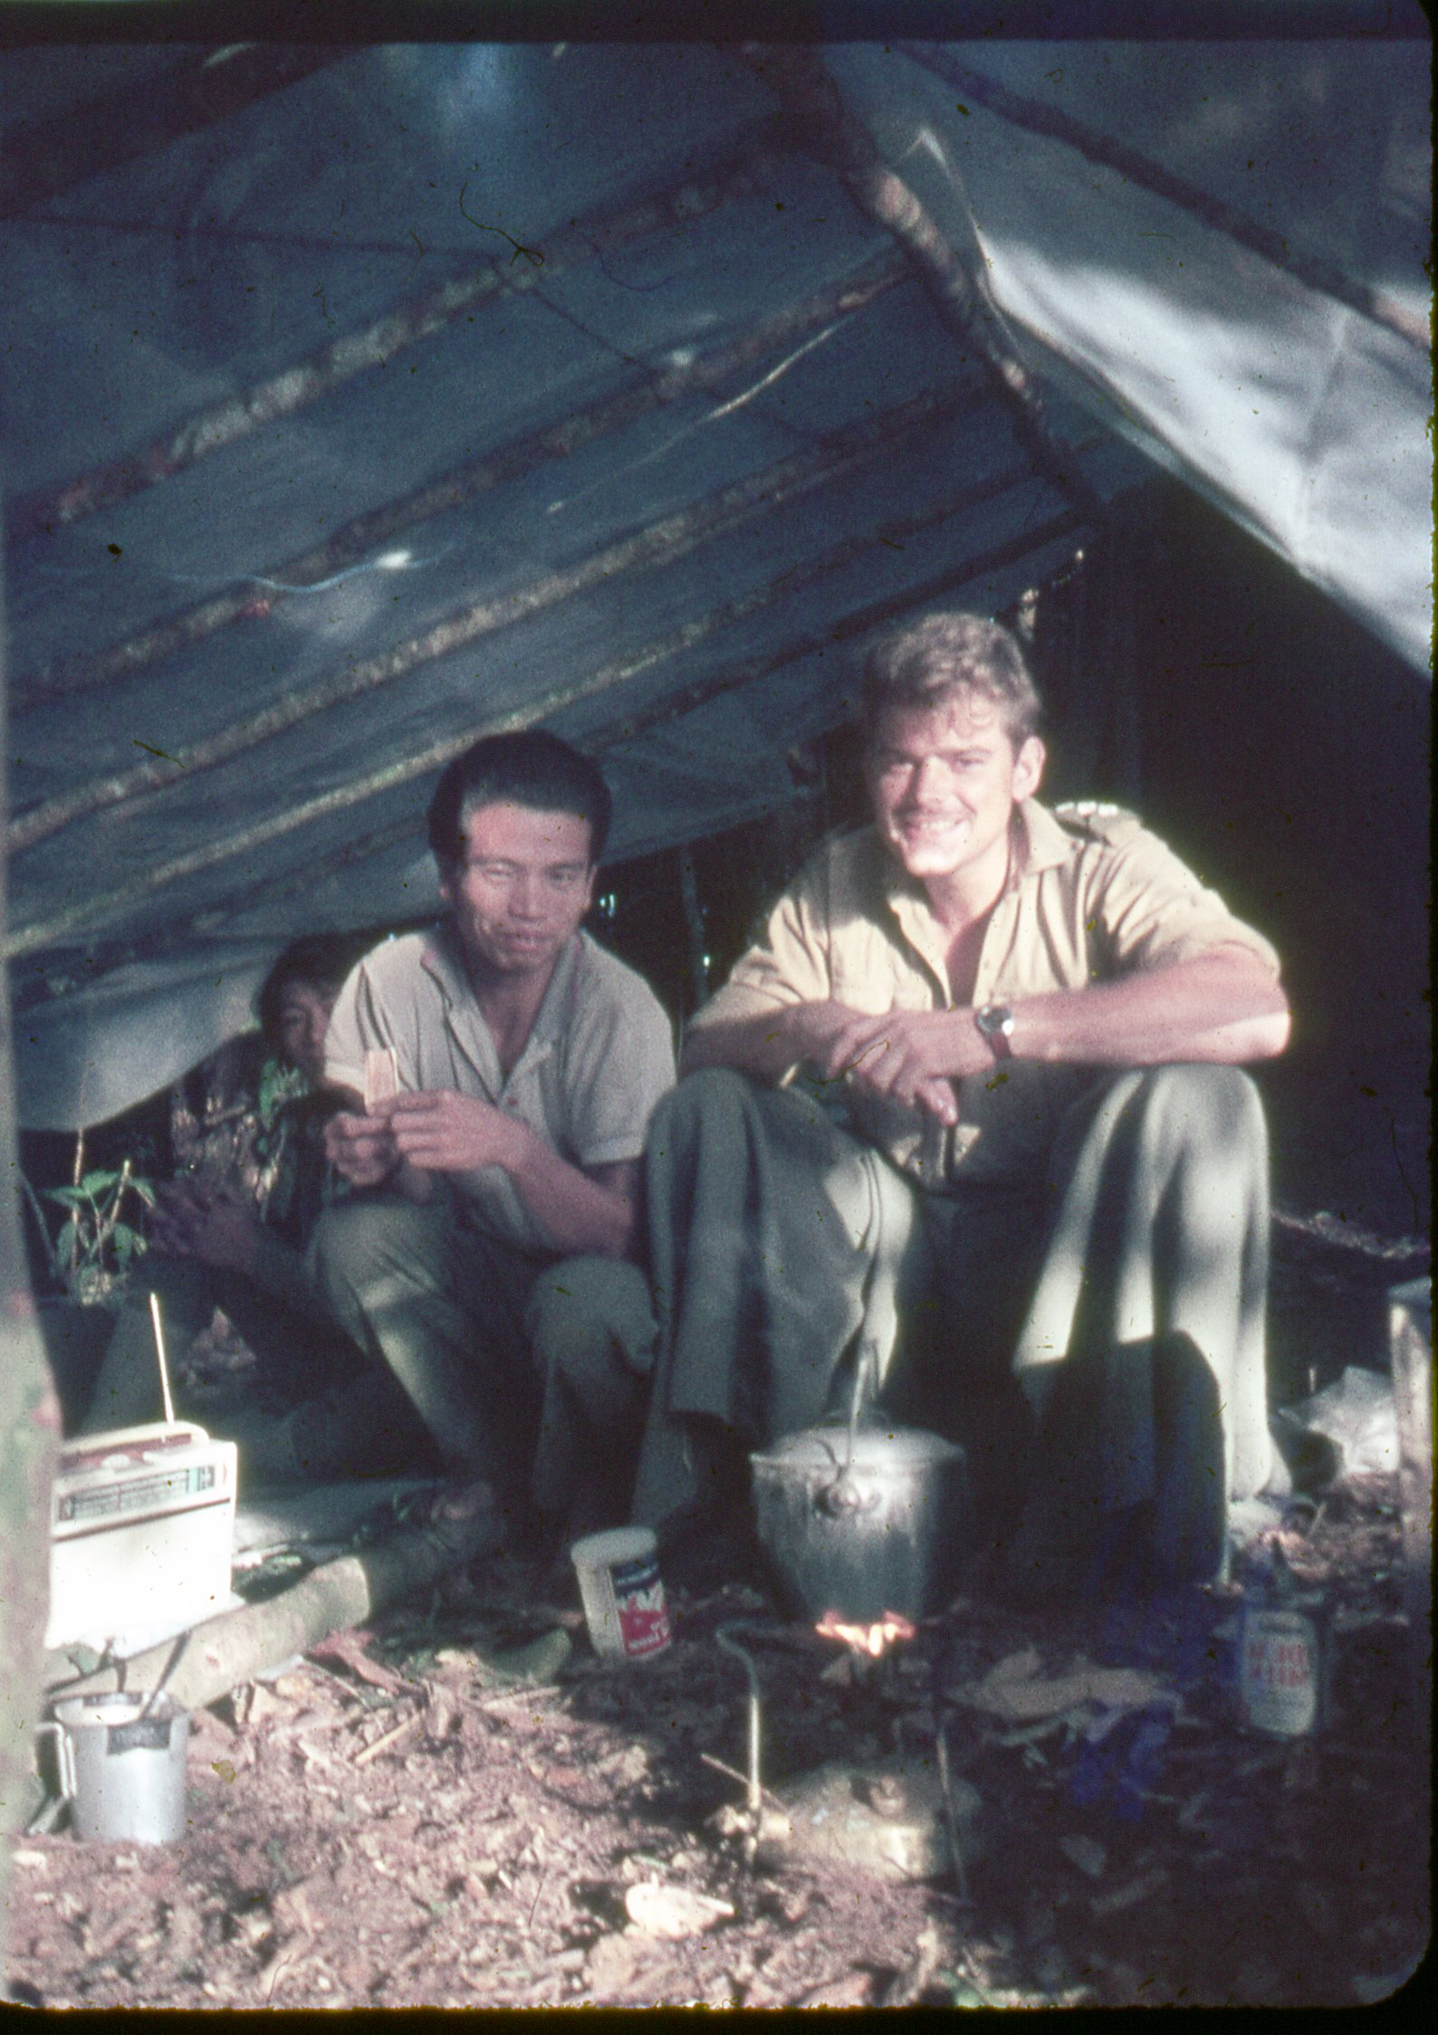
Sulap or shelter made from plastic sheeting.
Barok cooking rice.

Slide 17
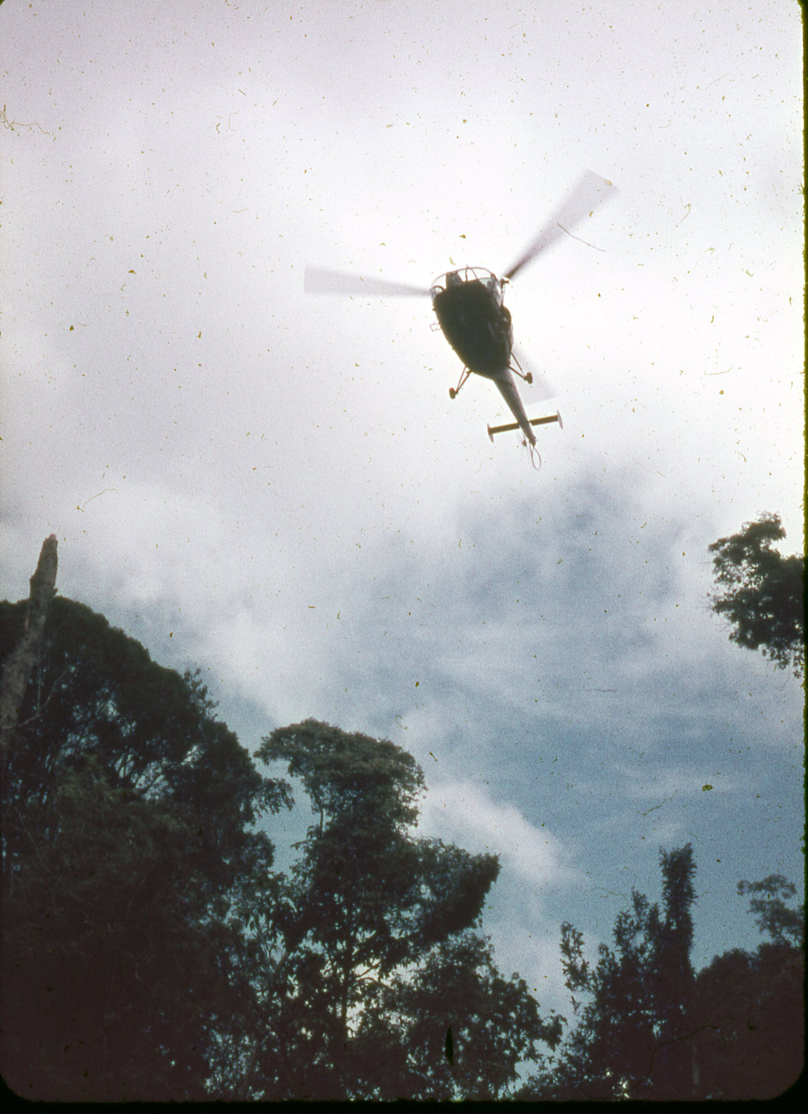
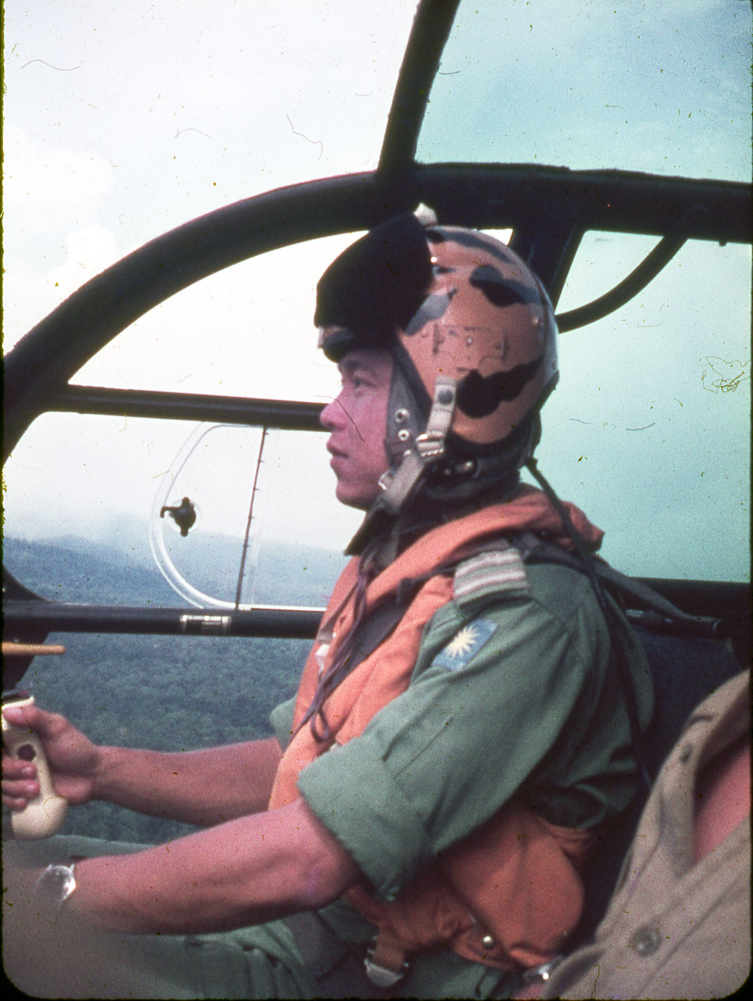
Alouette III
“Bunny” Chua, Alouette III pilot.

Slide 18
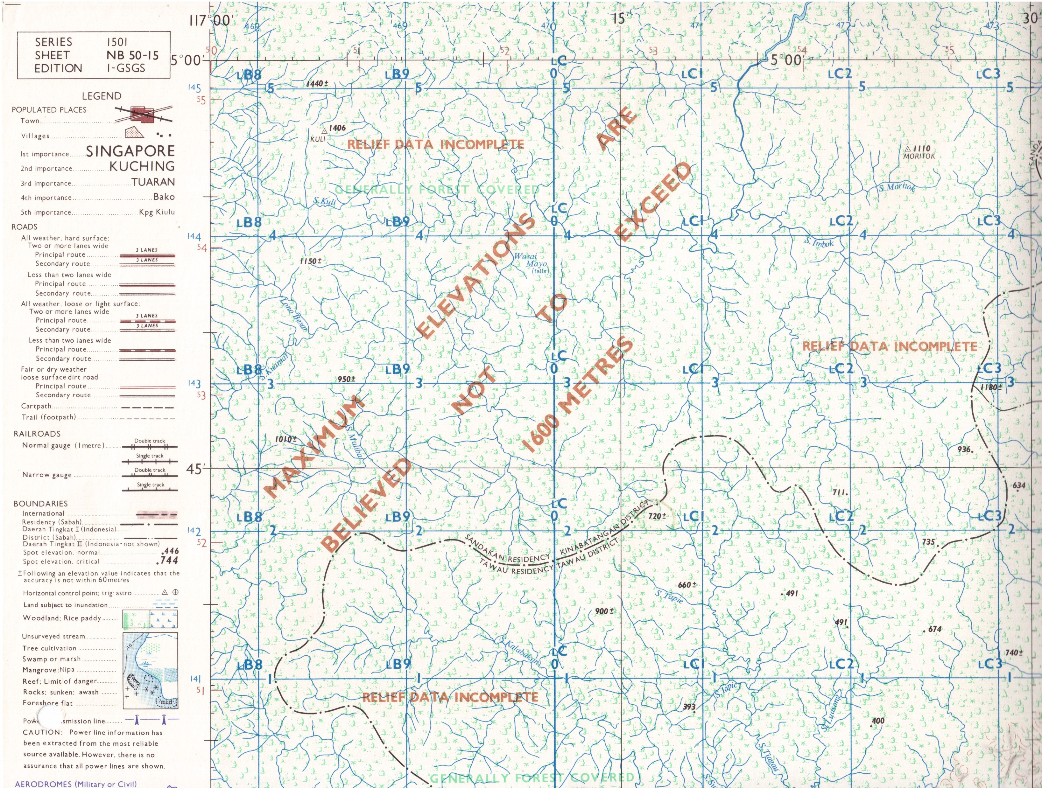
Series 1501 Sheet NB 50-15, Edition 1-GSGS.
Sheets of this series were being introduced in the mid 1960’s to replace Series T503.
On this later map, heights are shown in metres.
Hill 2360 is shown here as spot height 720.
720 may be seen at grid ref LC 0722, just south of the Sandakan and Tawau Residencies border.
Trig point Moritok may be seen at grid ref LC 2345.

Slide 19
Evening view west from Hill 2360/720 towards the Lotung Ridge in the heart of Sabah.

